Slide 1

Fabrication of graphitic-carbon suspended nanowires through mechano-electrospinning of photo-crosslinkable polymers
Osamu Katagiri-Tanaka A01212611@itesm.mx
Principal Advisor: Dr. Héctor Alán Aguirre Soto Co-advisor and Director of Program: Dra. Dora Iliana Medina Medina
25 Nov 2020

Slide 2
Agenda
Motivation & Problem Statement : 10 min
Objectives : 3 min
NFES literature review : 10 min
Rheology Analyses : 10 min
Fabrication & Characterization : 5 min
Conclusions & Future Work : 3 min

Slide 3
Motivation & Problem Statement

Slide 4
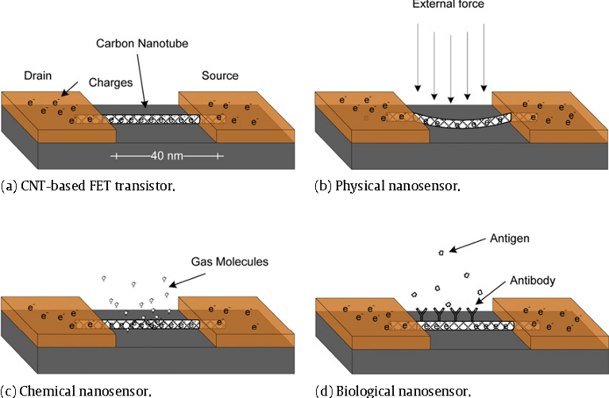
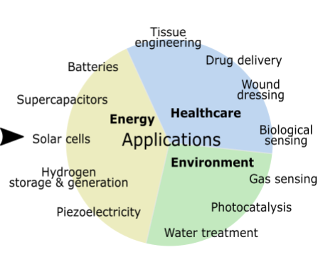
Glass-like Carbon NWs: Applications
V. Baudrit J, Recycling and Elimination of Wastes obtained from Agriculture by using Nanotechnology: Nanosensors, Int. J. Biosens. Bioelectron. 3 (2017) 368–375.https://doi.org/10.15406/ijbsbe.2017.03.00084.
R.L. McCreery, Advanced Carbon Electrode Materials for Molecular Electrochemistry, Chem. Rev. 108 (2008) 2646–2687. https://doi.org/10.1021/cr068076m.
G. Speranza, The Role of Functionalization in the Applications of Carbon Materials: An Overview, C — J. Carbon Res. 5 (2019) 84. https://doi.org/10.3390/c5040084.
Notes:
Remove general words (Applocations -> detection/sensors)
Problemas que solucionan estos sensores (contaminantes en agua, aire, temperatura en electrónicos, health care)

Slide 5
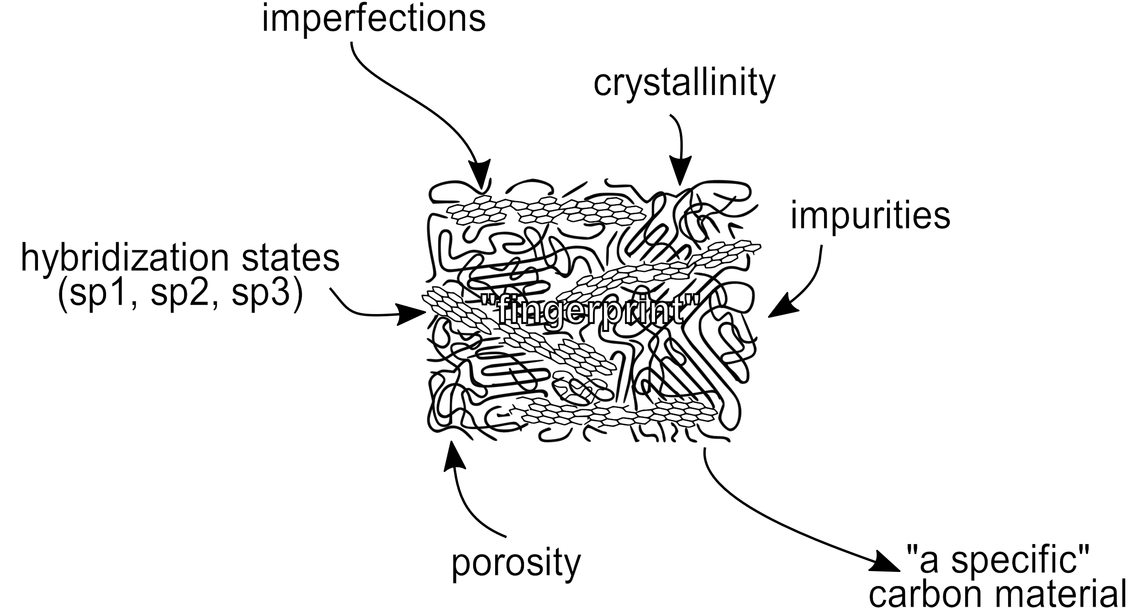
Carbon Based Nanomaterials (CBNs)
The crystallite size, molecular arrangement, and anisotropy determine the material’s properties.
The interminable collection of CBNs range from soft, conductive lubricants to very hard, low conductivity solids; and from black colour, bulks to transparent, disordered thin films
R.L. McCreery, Advanced Carbon Electrode Materials for Molecular Electrochemistry, Chem. Rev. 108 (2008) 2646–2687. https://doi.org/10.1021/cr068076m.
S. Beigi-boroujeni, O. Katagiri-tanaka, B. Cardenas-benitez, O. Sergio, A. Aguirre-soto, Pyrolytic Carbon from Novolac Epoxy Resin Compressed before Photocrosslinking and Pyrolysis, Mater. Today Proc. (2020).
Notes:
* Classification in a diagram with ranges and units (characterization techniques)

Slide 6
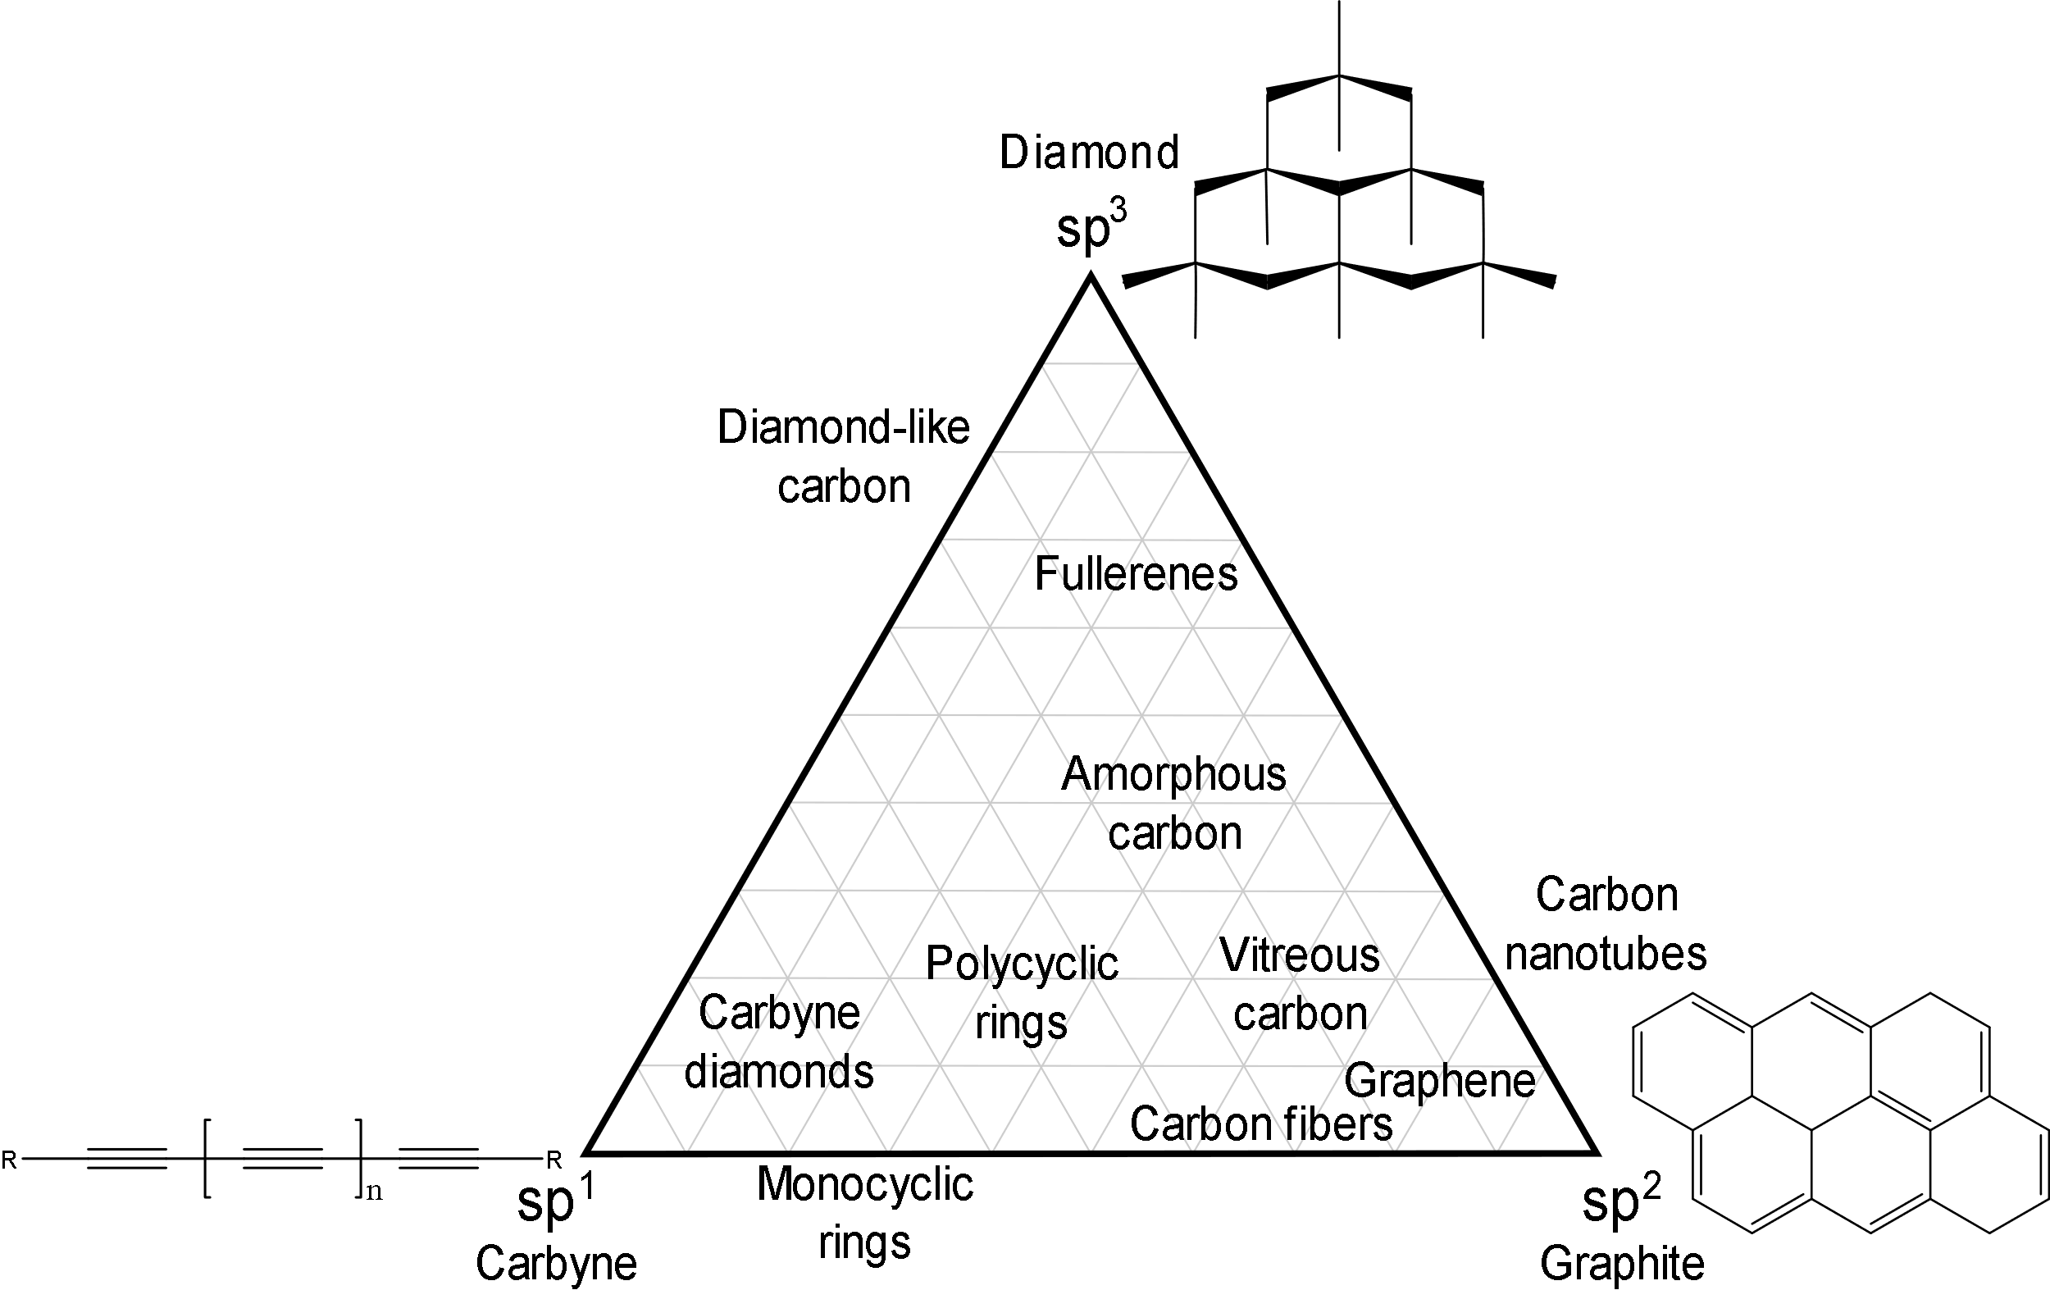
Carbon allotropes
R.B. Heimann, S.E. Evsvukov, Y. Koga, Carbon allotropes: a suggested classification scheme based on valence orbital hybridization, Carbon N. Y. 35 (1997) 1654–1658. https://doi.org/10.1016/S0008-6223(97)82794-7.
Е.А. Belenkov, Classification of carbon structures, in: Carbon Nanotub. Graphene, Chelyabinsk State University, Chelyabinsk, Russia, 2003: p. 5.
M. Fedel, Blood compatibility of diamond-like carbon (DLC) coatings, in: Diamond-Based Mater. Biomed. Appl., Elsevier, 2013: pp. 71–102. https://doi.org/10.1533/9780857093516.1.71.
M. Razeghi, Fundamentals of Solid State Engineering, Springer International Publishing, Cham, 2019. https://doi.org/10.1007/978-3-319-75708-7.
K. Alstrup Jensen, J. Bøgelund, P. Jackson, N. Raun Jacobsen, R. Birkedal, P. Axel Clausen, A. Thoustrup Saber, H. Wallin, U. Birgitte Vogel, Carbon nanotubes - Types, products, market, and provisional assessment of the associated risks to man and the environment, The Danish Environmental Protection Agency, 2015.

Slide 7
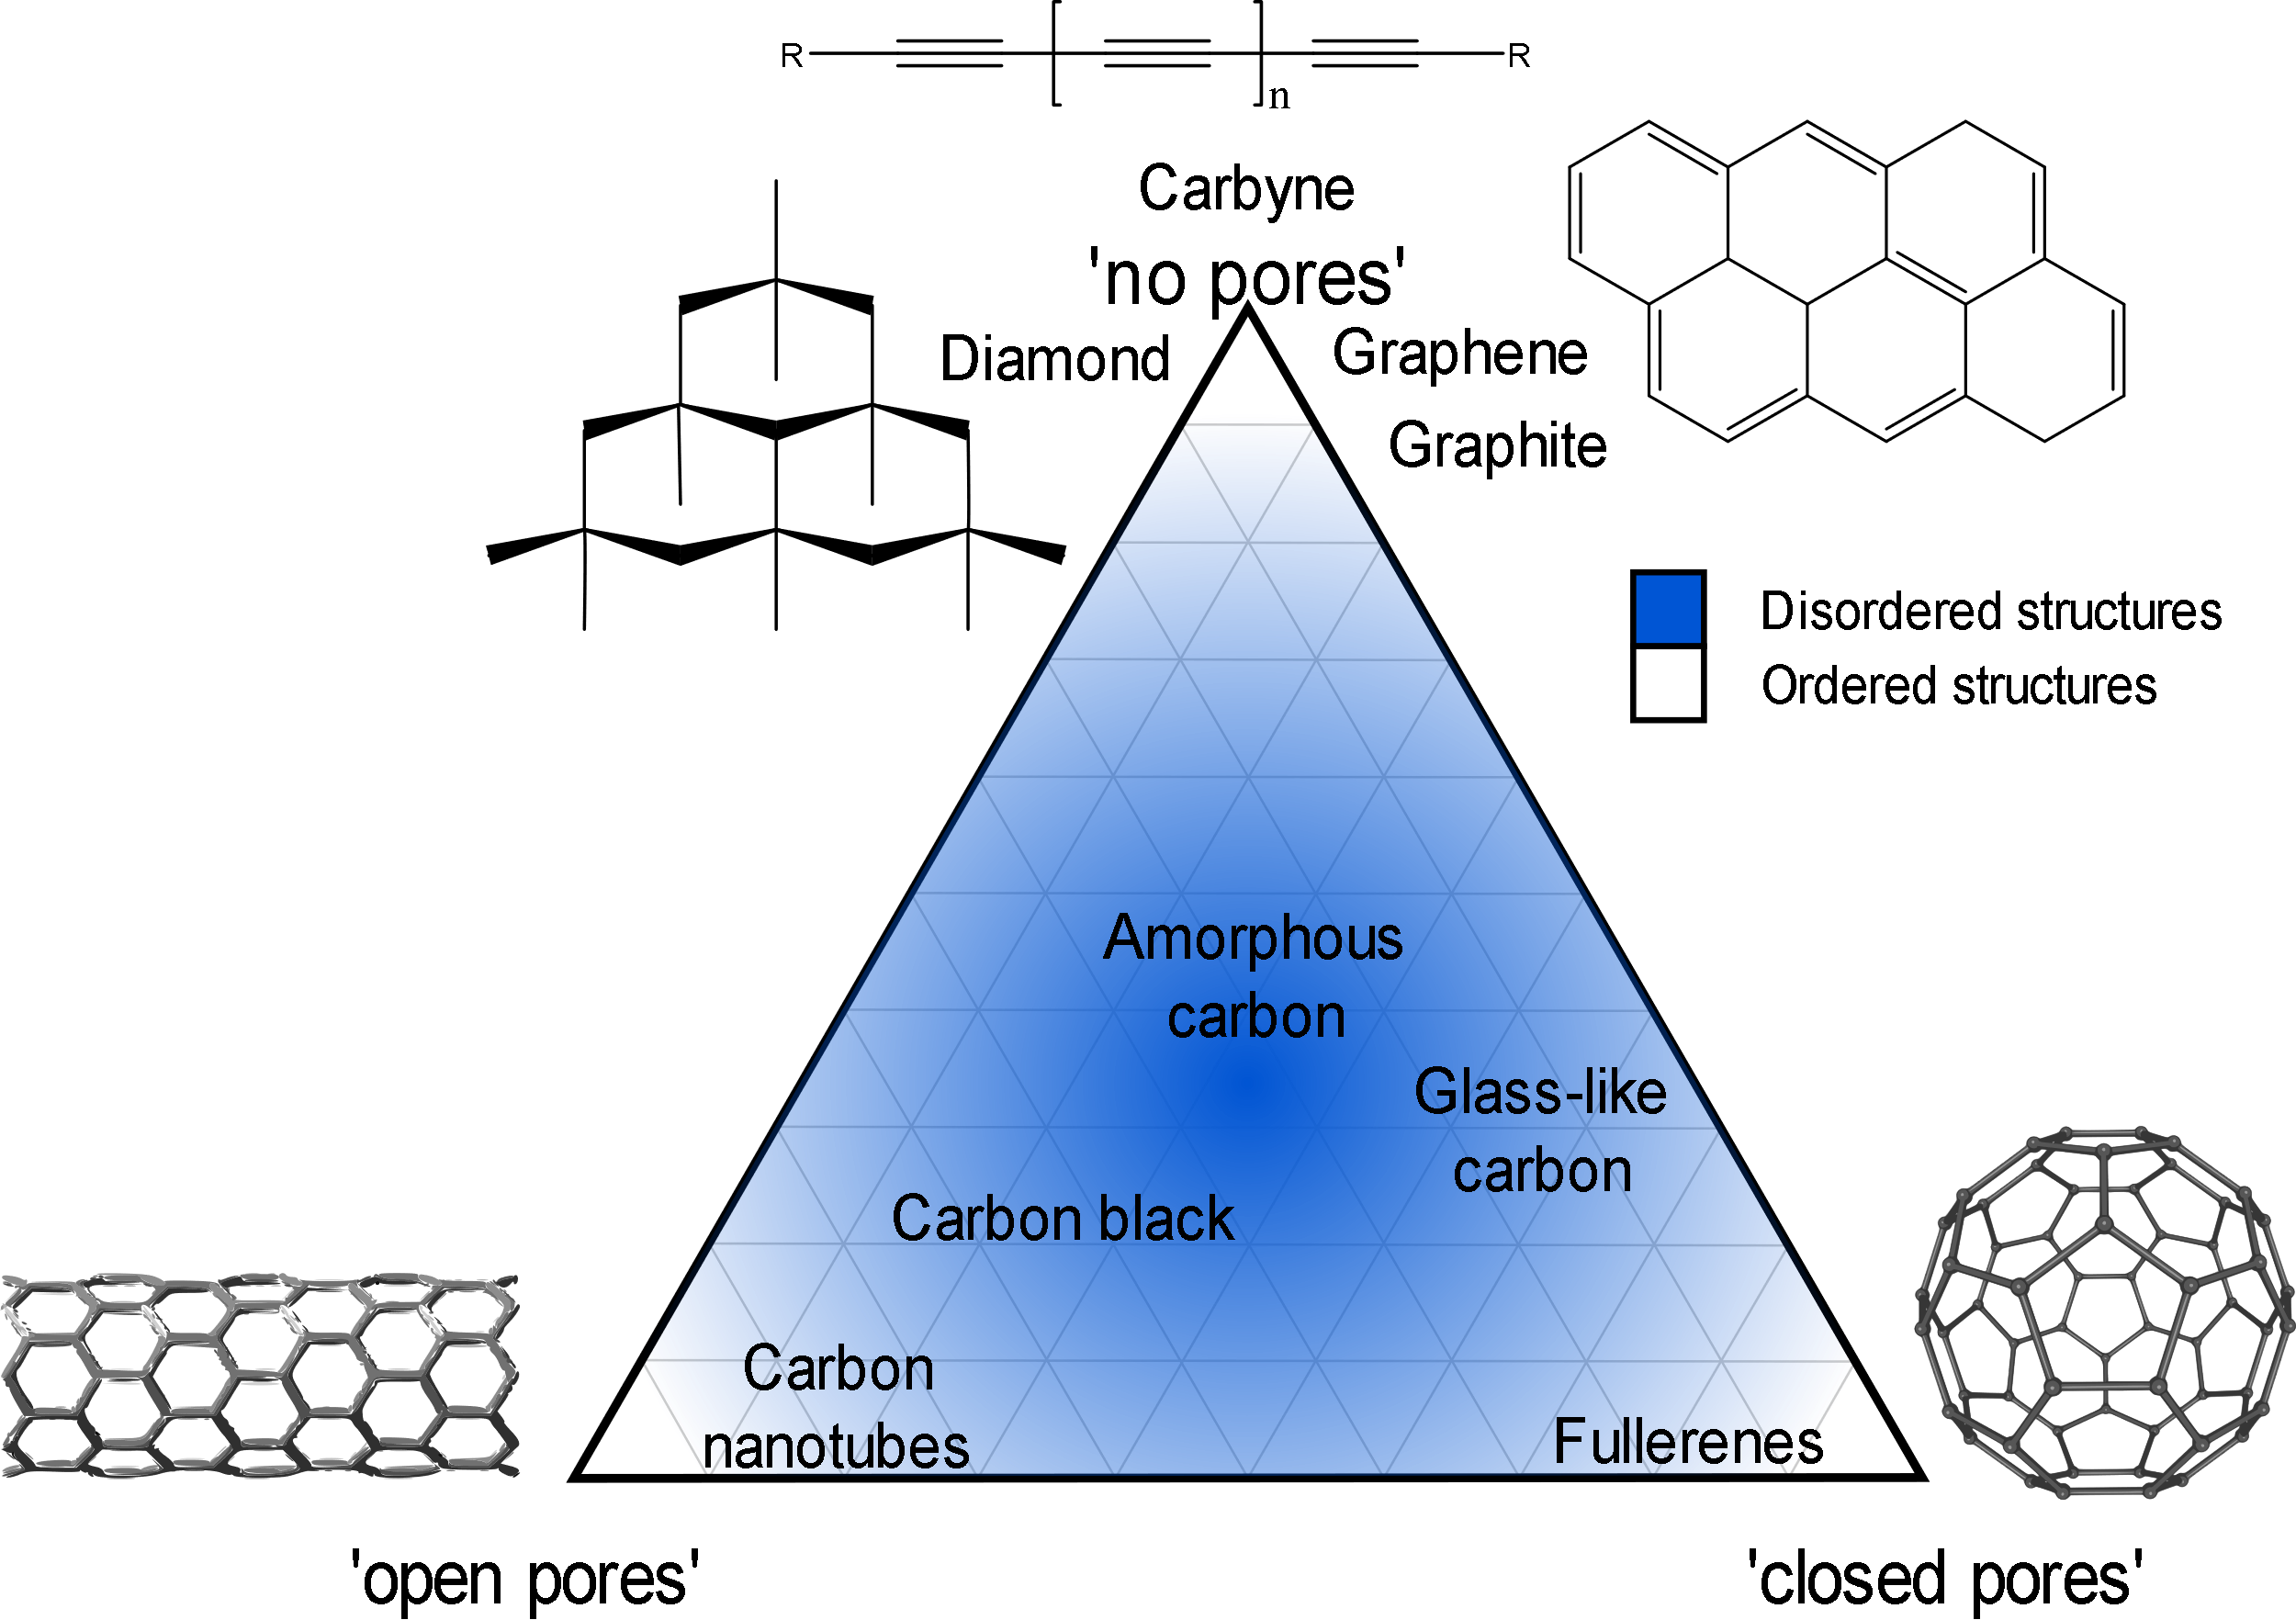
Carbon allotropes
R.L. McCreery, Advanced Carbon Electrode Materials for Molecular Electrochemistry, Chem. Rev. 108 (2008) 2646–2687. https://doi.org/10.1021/cr068076m.
S. Beigi-boroujeni, O. Katagiri-tanaka, B. Cardenas-benitez, O. Sergio, A. Aguirre-soto, Pyrolytic Carbon from Novolac Epoxy Resin Compressed before Photocrosslinking and Pyrolysis, Mater. Today Proc. (2020).
Harry Marsh. Introduction to Carbon Science. Vol. 46. 1. Elsevier, Apr. 1989, p. 43. ISBN: 9780408038379. DOI: 10.1016/C2013- 0- 04111- 4. URL: https: //linkinghub.elsevier.com/retrieve/pii/C20130041114.
Pierson Hugh. Handbook of Carbon, Graphite, Diamonds and Fullerenes. Elsevier, 1994, p. 419. ISBN: 9780815513391.
Notes:
Add Triangle diagram
Focus in GLC

Slide 8
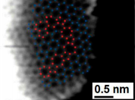
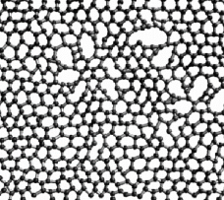
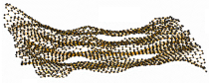
Glass-like Carbon
Attractive for its electrochemical stability, thermal resistance, electrical conductivity, biocompatibility and is gas impermeable.
It is used in the manufacture of semiconductors.
R.L. McCreery, Advanced Carbon Electrode Materials for Molecular Electrochemistry, Chem. Rev. 108 (2008) 2646–2687. https://doi.org/10.1021/cr068076m.
G. Speranza, The Role of Functionalization in the Applications of Carbon Materials: An Overview, C — J. Carbon Res. 5 (2019) 84. https://doi.org/10.3390/c5040084.

Slide 9


MicroChem’s SU-8 & Tokai’s recipe
Electrical resistivity, comparison:
highly oriented pyrolytic graphite (HOPG)
<
TOKAI Glassy carbon
<
SU-8 glass-like carbon
x10³
x4
Tokai’s recipe is a secret …
R.L. McCreery, Advanced Carbon Electrode Materials for Molecular Electrochemistry, Chem. Rev. 108 (2008) 2646–2687. https://doi.org/10.1021/cr068076m.
G. Speranza, The Role of Functionalization in the Applications of Carbon Materials: An Overview, C — J. Carbon Res. 5 (2019) 84. https://doi.org/10.3390/c5040084.
Notes:
* Focus in microchem

Slide 10
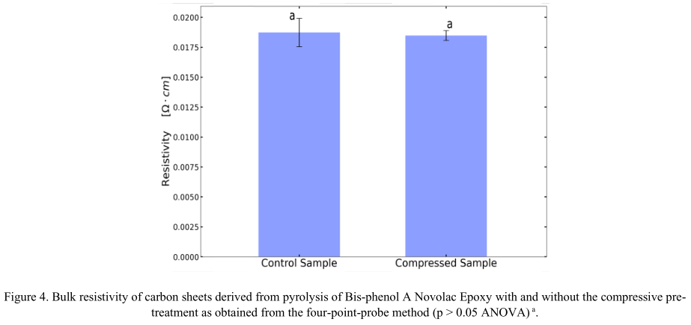
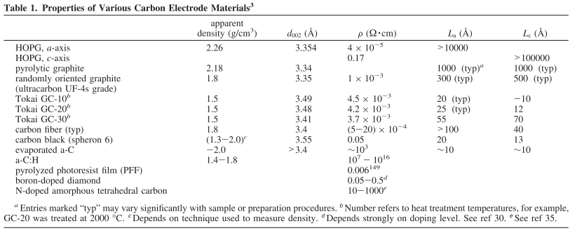
MicroChem’s SU-8 & Tokai’s recipe
SU-8
glass-like carbon resistivity:
<content> <key concept>
R.L. McCreery, Advanced Carbon Electrode Materials for Molecular Electrochemistry, Chem. Rev. 108 (2008) 2646–2687. https://doi.org/10.1021/cr068076m.
G. Speranza, The Role of Functionalization in the Applications of Carbon Materials: An Overview, C — J. Carbon Res. 5 (2019) 84. https://doi.org/10.3390/c5040084.

Slide 11
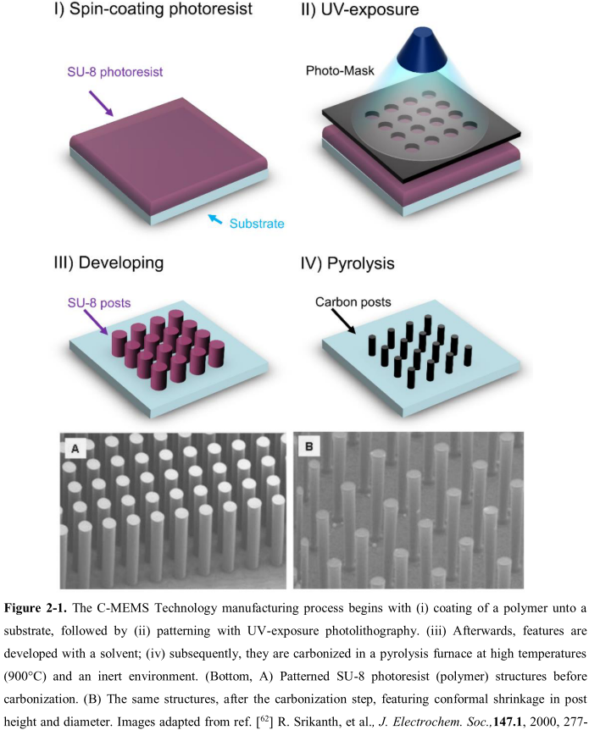
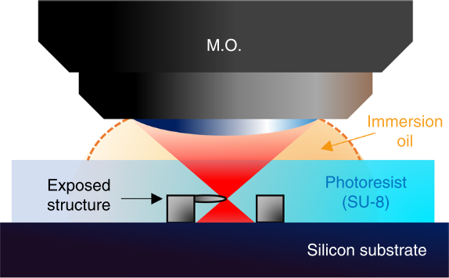
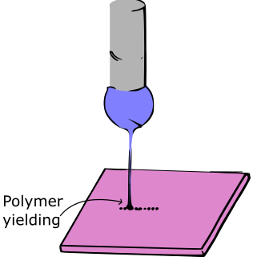
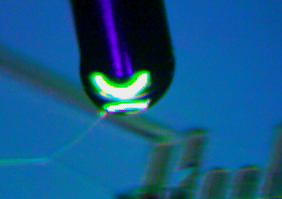
Current approaches
Photolithography
Physical & Optical Limitations
Two-Photon Polymerization (TPP)
Slow (mm per sec) & Expensive
*Near-Field Electrospinning (NFES)
Suspended Nanowires w/Spatial Control
V. Galstyan, M. Bhandari, V. Sberveglieri, G. Sberveglieri, E. Comini, Metal Oxide Nanostructures in Food Applications: Quality Control and Packaging, Chemosensors. 6 (2018) 16. https://doi.org/10.3390/chemosensors6020016.
D. Kluge, J.C. Singer, B.R. Neugirg, J.W. Neubauer, H.-W. Schmidt, A. Fery, Top–down meets bottom–up: A comparison of the mechanical properties of melt electrospun and self-assembled 1,3,5-benzenetrisamide fibers, Polymer (Guildf). 53 (2012) 5754–5759. https://doi.org/10.1016/j.polymer.2012.10.016.

Slide 12
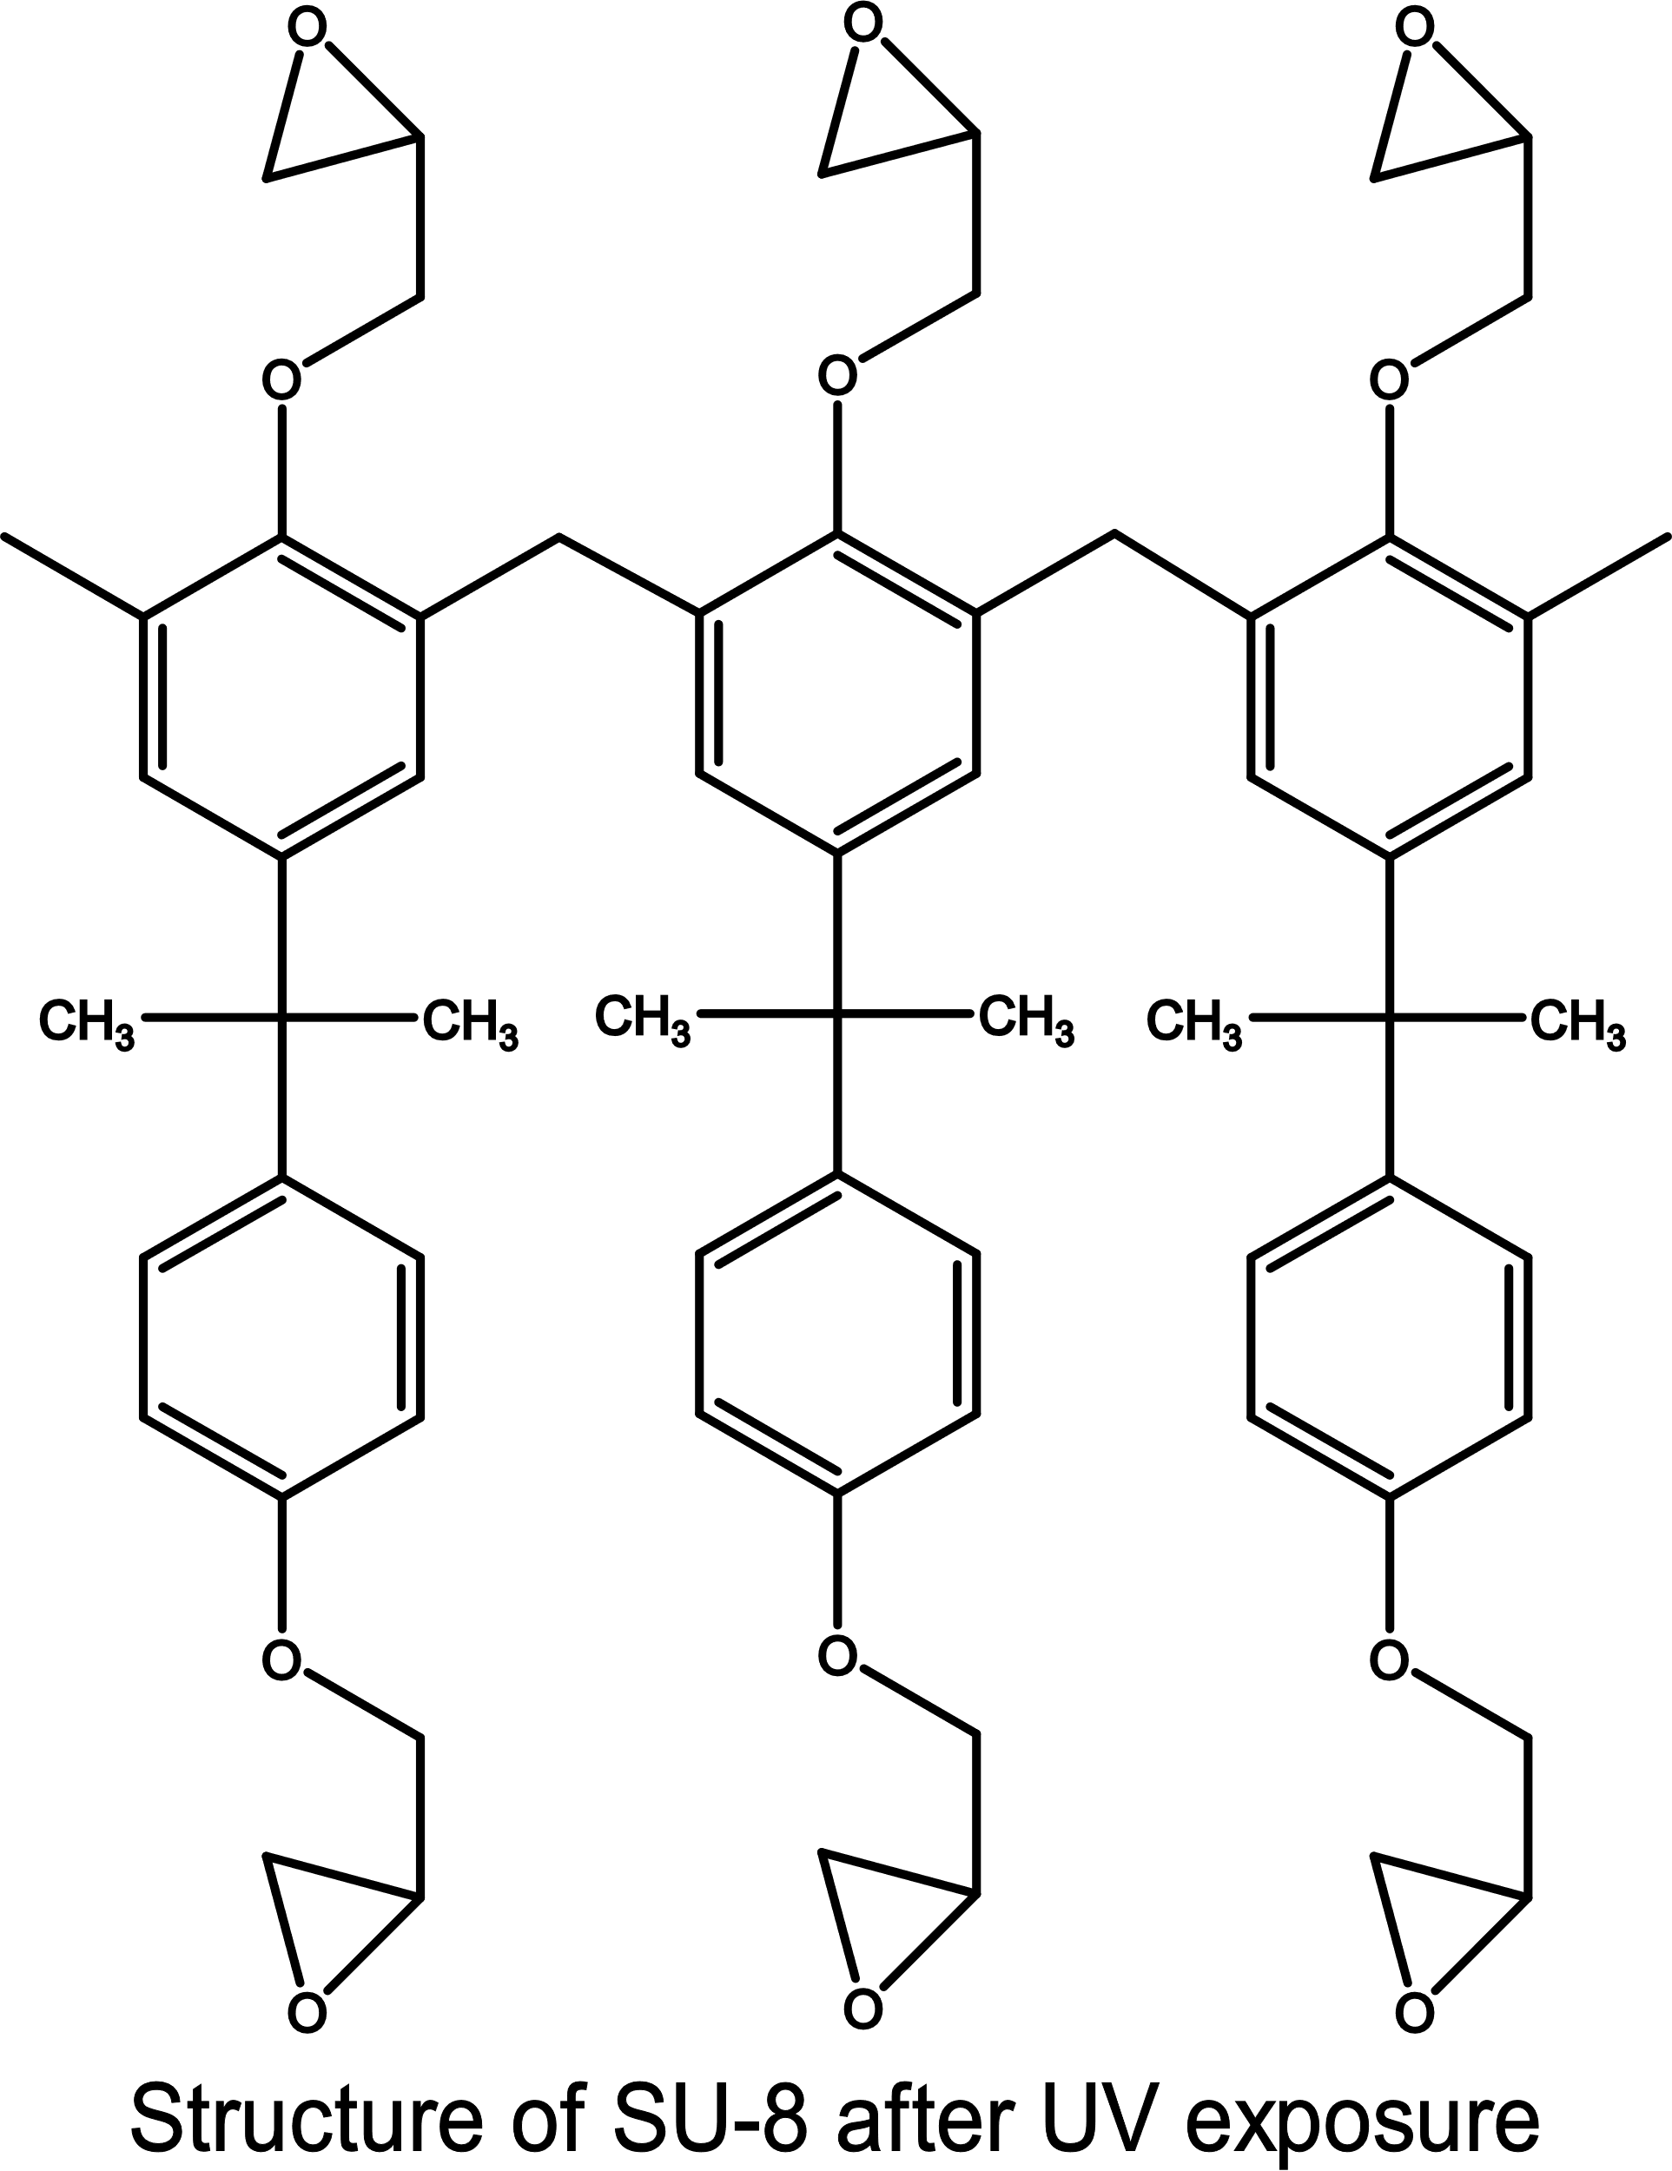
MicroChem’s SU-8
Pyrolysis of SU8 is currently the typical method to produce glass-like carbon.
Polymer patterning through photolithography
Carbonization through pyrolysis
However, photolithography generates waste in the spin-coating and developing steps. Also, it presents structural limitations.
Limitations can be overcome with other fabrication techniques, such as NFES
Microchem, Su-8 2000.5-2015, 2000.5, 2002, 2005, 2007, 2010, 2015. (2006) 1–5. papers3://publication/uuid/859F51B9-0382-4DE8-88A9-267F936939A3.

Slide 13
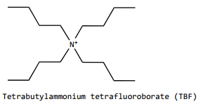
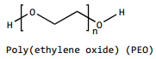
MicroChem’s SU-8
However, SU-8 as is not electrospinnable
SU-8 does not have the right viscosity & solution conductivity.
SU-8 is design for photolithography.
SU-8 + TBF + PEO formulation:
TBF to increase the solution conductivity
& PEO to provided the required viscosity
… both needed for smooth PEO flow during electrospinning
D.R. Flores, Role of rheological properties in near field electrospun fibers morphology, (2017) 130.
B. Cárdenas Benítez, Advanced Manufacturing Techniques for the Fabrication and Surface Modification of Carbon Nanowires, Tecnológico de Monterrey, 2017.
Notes:
Remove background from figures
Para las aplicationes necesito que sea electrospinnalbe
Photolithography-able vs. Electrospinnableility
Highlight the PEO

Slide 14
Problem Statement
Properties of an electrospun fiber depend on many parameters,
and each parameter also depends on the polymer-solvent system.
Solution Parameters:
Concentration
Molecular weight
Viscosity
Electrical conductivity
Ambient Parameters:
Humidity
Temperature
Process Parameters:
Applied Voltage
Flow rate
Working distance
The interdependence between the process and solution parameters presents a challenge to predict the fiber diameter.
S.B. Gadkari, Scaling analysis for electrospinning, Springerplus. 3 (2014) 705. https://doi.org/10.1186/2193-1801-3-705.
Notes:
Predicción de diámetro y control espacial
Mention my important parameters: conductivity low diameter spatial control
Challenge de control de diametro

Slide 15
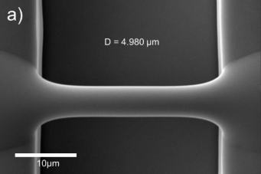
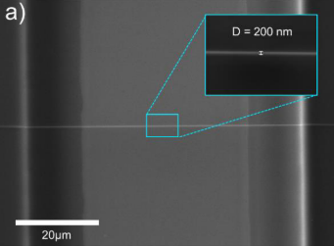
Best Results so far by NFES (previous work)
Fiber yield rate of 81 %
Fiber diameter before pyrolysis of 4.966 μm
Fiber diameter after pyrolysis of 204 nm
Fiber length of 60.5 ± 4.3 μm
Fiber resistance from 407 KΩ to 1.727 MΩ
wt% PEO 0.25 | SU-8 2002 [mg] | PEO [mg] | TBF [mg]
 | 2246 | 5.65 | 11.32
D.R. Flores, Role of rheological properties in near field electrospun fibers morphology, (2017) 130.
B. Cárdenas Benítez, Advanced Manufacturing Techniques for the Fabrication and Surface Modification of Carbon Nanowires, Tecnológico de Monterrey, 2017.

Slide 16
Implications of PEO
The fiber yield rate and fiber conductivity are impacted negatively as PEO introduces more oxygen to the solution
Some samples are destroyed during pyrolysis
High variance in the obtained conductivity across samples.
The addition of oxygen modifies the carbon structure.
D.R. Flores, Role of rheological properties in near field electrospun fibers morphology, (2017) 130.
B. Cárdenas Benítez, Advanced Manufacturing Techniques for the Fabrication and Surface Modification of Carbon Nanowires, Tecnológico de Monterrey, 2017.
Notes:
Diagram – PEO pyrolysis
Mention the rol of Oxygen – abd connect it witht the desired characteristics – closed porous
Pyrolysis stages
Balance of properties

Slide 17
Objectives

Slide 18
Objectives
General. Formulate polymer/solvent combinations that have the greatest potential to replace or modify the SU-8/PEO formulation for the fabrication of microscopic polymer fibers that may be converted to conductive suspended carbon nano-wires.
Specific1. Learn how the diameter of the electrospun polymer fiber can be controlled by appropriate tuning of the NFES parameters and solution properties.
Specific2. Through rheological analyses, determine if polymer solutions have comparative viscoelastic properties to those of the SU-8/PEO benchmark, and if they can be easily electrospun by NFES.
Specific3. Propose alternatives to the SU-8/PEO benchmark formulation for the production of microscopic polymer fibers with potential for the fabrication of carbon nano-wires.

Slide 19
NFES literature review
Specific Objective 1. Learn how the diameter of the electrospun polymer fiber can be controlled by appropriate tuning of the NFES parameters and solution properties.
Notes:
To find substitutions to keep
Spatial control, high conductivity, low diameter
Find new formulations or replace PEO in SU8 -> find new materials

Slide 20
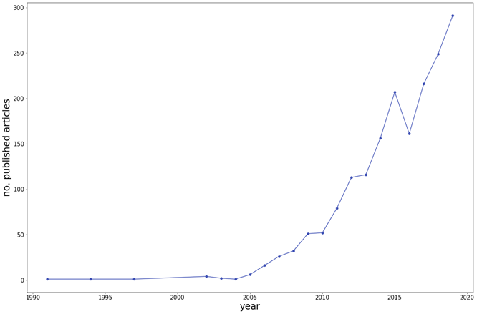
Methods: NFES literature (first NFES apparatus built in 2003 by J. Kameoka et al.)
Thinnest fiber achieved by C. Chang et al. with ~50 nm in diameter. (PEO in water)
However, fiber yield rate was not reported
J. Kameoka, R. Orth, Y. Yang, D. Czaplewski, R. Mathers, G.W. Coates, H.G. Craighead, A scanning tip electrospinning source for deposition of oriented nanofibres, Nanotechnology. 14 (2003) 1124–1129. https://doi.org/10.1088/0957-4484/14/10/310.
C. Chang, K. Limkrailassiri, L. Lin, Continuous near-field electrospinning for large area deposition of orderly nanofiber patterns, Appl Phys Lett. (2008) 3. https://doi.org/10.1063/1.2975834.

Slide 21
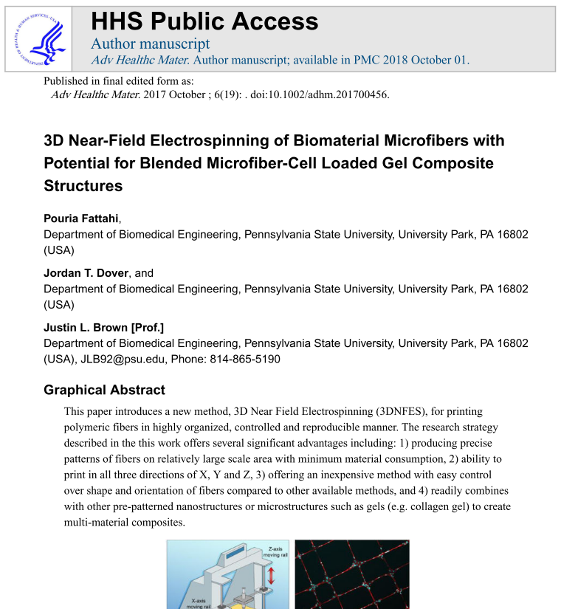
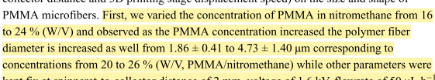
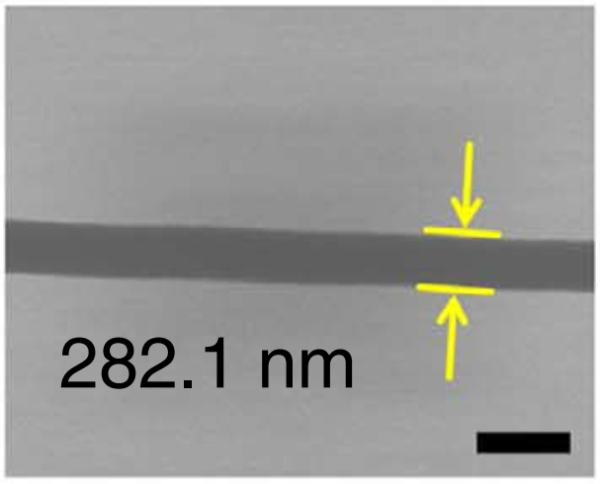
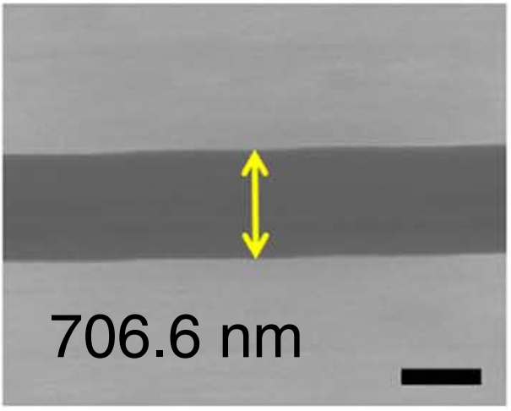
Methods: Data collection (analysis of NFES articles from 2003 to 2020)
The author mentions the process parameters and fiber properties within the article in writing.
Fattahi2017
Figures from Min2013
S.-Y. Min, T.-S. Kim, B.J. Kim, H. Cho, Y.-Y. Noh, H. Yang, J.H. Cho, T.-W. Lee, Large-scale organic nanowire lithography and electronics, Nat. Commun. 4 (2013) 1773. https://doi.org/10.1038/ncomms2785.
P. Fattahi, J.T. Dover, J.L. Brown, 3D Near-Field Electrospinning of Biomaterial Microfibers with Potential for Blended Microfiber-Cell-Loaded Gel Composite Structures, Adv. Healthc. Mater. 6 (2017) 1700456. https://doi.org/10.1002/adhm.201700456.

Slide 22
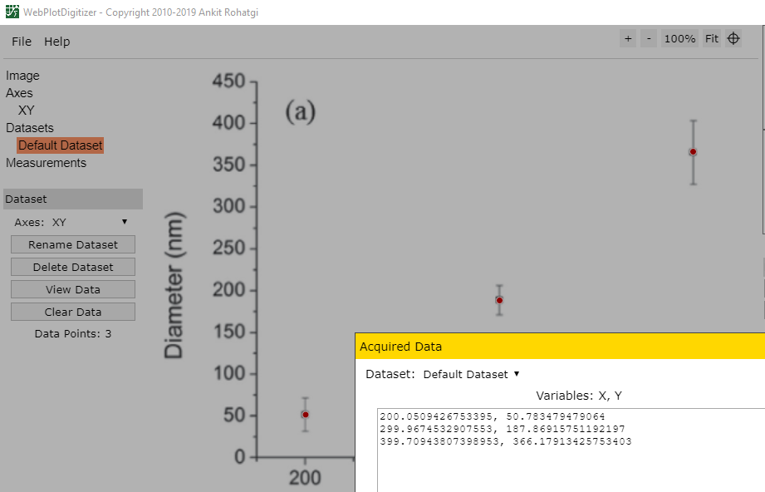
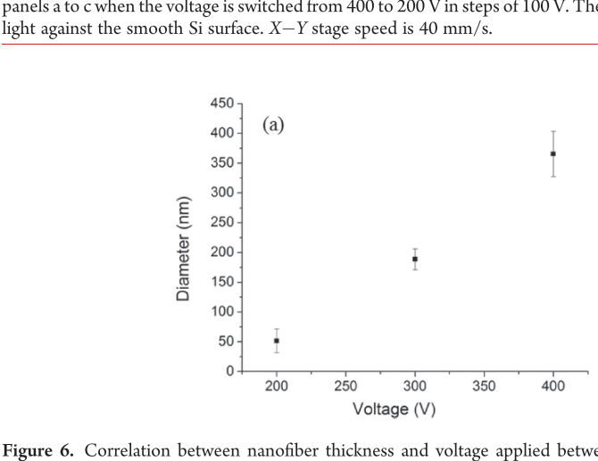
Methods: Data collection (analysis of NFES articles from 2003 to 2020)
The author provides the data in plots and graphs.
WebPlotDigitalizer (https://github.com/ankitrohatgi/WebPlotDigitizer):
M.J. Madou, D. Dunn-Rankin, L. Kulinsky, A. Mirsepassi, G.S. Bisht, S. Oh, G. Canton, Controlled Continuous Patterning of Polymeric Nanofibers on Three-Dimensional Substrates Using Low-Voltage Near-Field Electrospinning, Nano Lett. 11 (2011) 1831–1837. https://doi.org/10.1021/nl2006164.
Applied voltage vs. fiber diameter by Madou2011

Slide 23
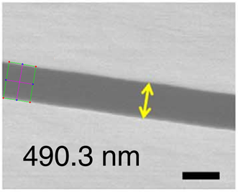
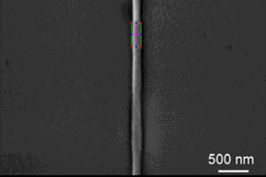
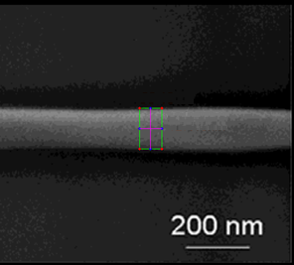
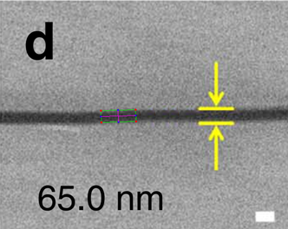
Methods: Data collection (analysis of NFES articles from 2003 to 2020)
The author does not mention the fiber diameter in writing but provides a EM characterization.
Python Image Analysis (with a 3.2% error in avg.):
Figures from Min2013
360.29 nm
493.2 nm
127.10 nm
63.21 nm
Figures from Camillo2013
S.-Y. Min, T.-S. Kim, B.J. Kim, H. Cho, Y.-Y. Noh, H. Yang, J.H. Cho, T.-W. Lee, Large-scale organic nanowire lithography and electronics, Nat. Commun. 4 (2013) 1773. https://doi.org/10.1038/ncomms2785..
https://github.com/katagirimx/OpenCV-image-measuring
D. Di Camillo, V. Fasano, F. Ruggieri, S. Santucci, L. Lozzi, A. Camposeo, D. Pisignano, Near-field electrospinning of conjugated polymer light-emitting nanofibers, Nanoscale. 5 (2013) 11637–11642. https://doi.org/10.1039/C3NR03094F.

Slide 24
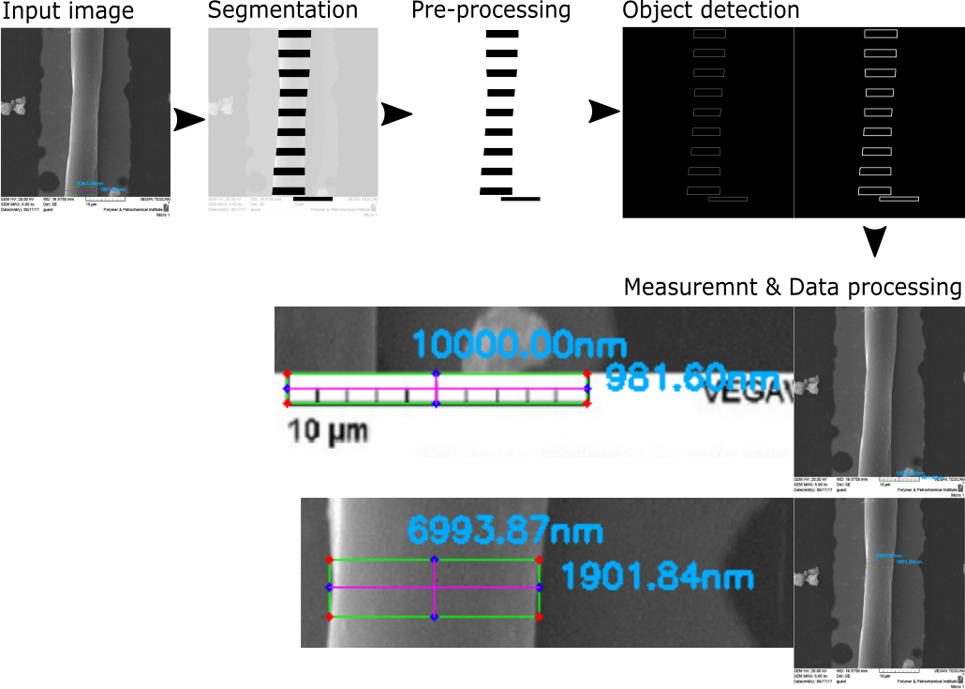
Methods: Data collection (analysis of NFES articles from 2003 to 2020)
The author does not mention the fiber diameter in writing but provides a EM characterization.

Slide 25
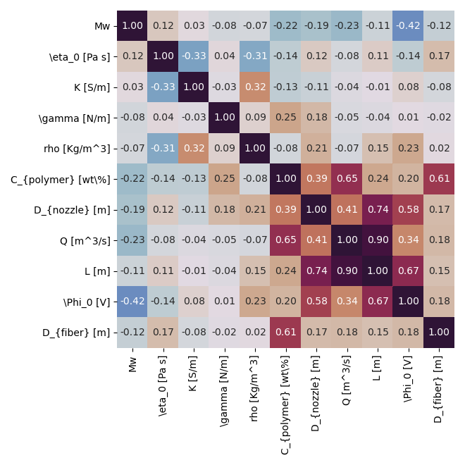
Relevant Parameters:
Matrix of Pearson linear correlation coefficients, built with Python’s seaborn package.
Zero-shear viscosity,
Polymer Concentration,
Solution Flow Rate,
&
Applied Voltage
are the main drivers of the final Fiber Diameter

Slide 26
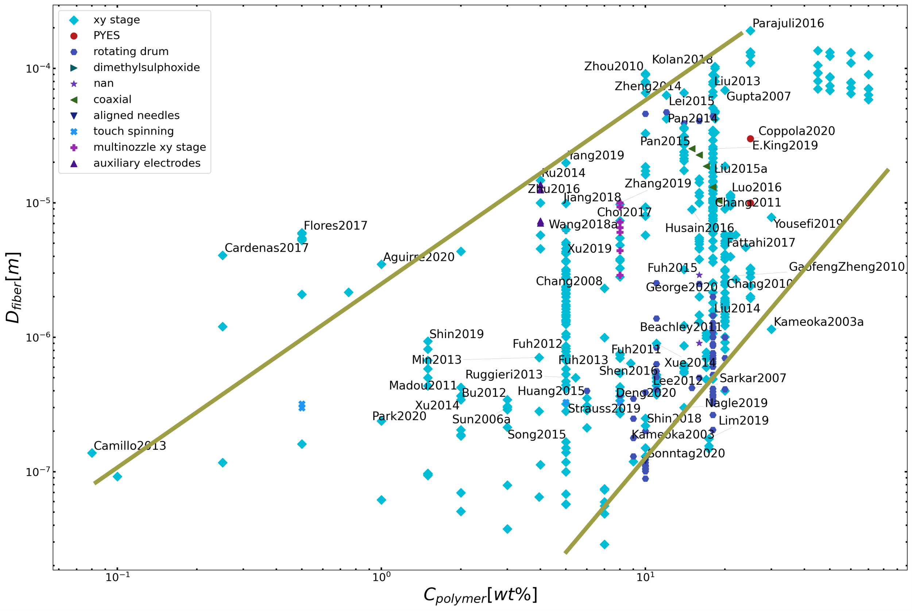
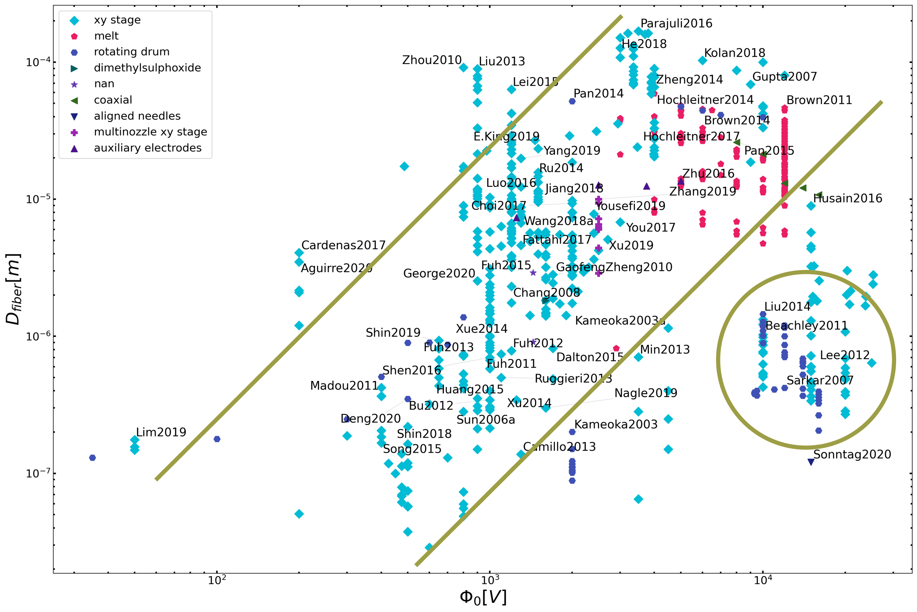
Conclusion 1.2: Let’s focus on polymer concentration
Polymer concentration is the most reliable process parameter to control the morphology of electrospun fibers. (regardless the type of NFES process)
Notes:
Song2015 : glass capillary tip
Brown201X : melt ES
Husain2016 : L = cm
Shin2019 : coiled/meander fibers
Parajuli2016 : concentrations 25 – 80%

Slide 27
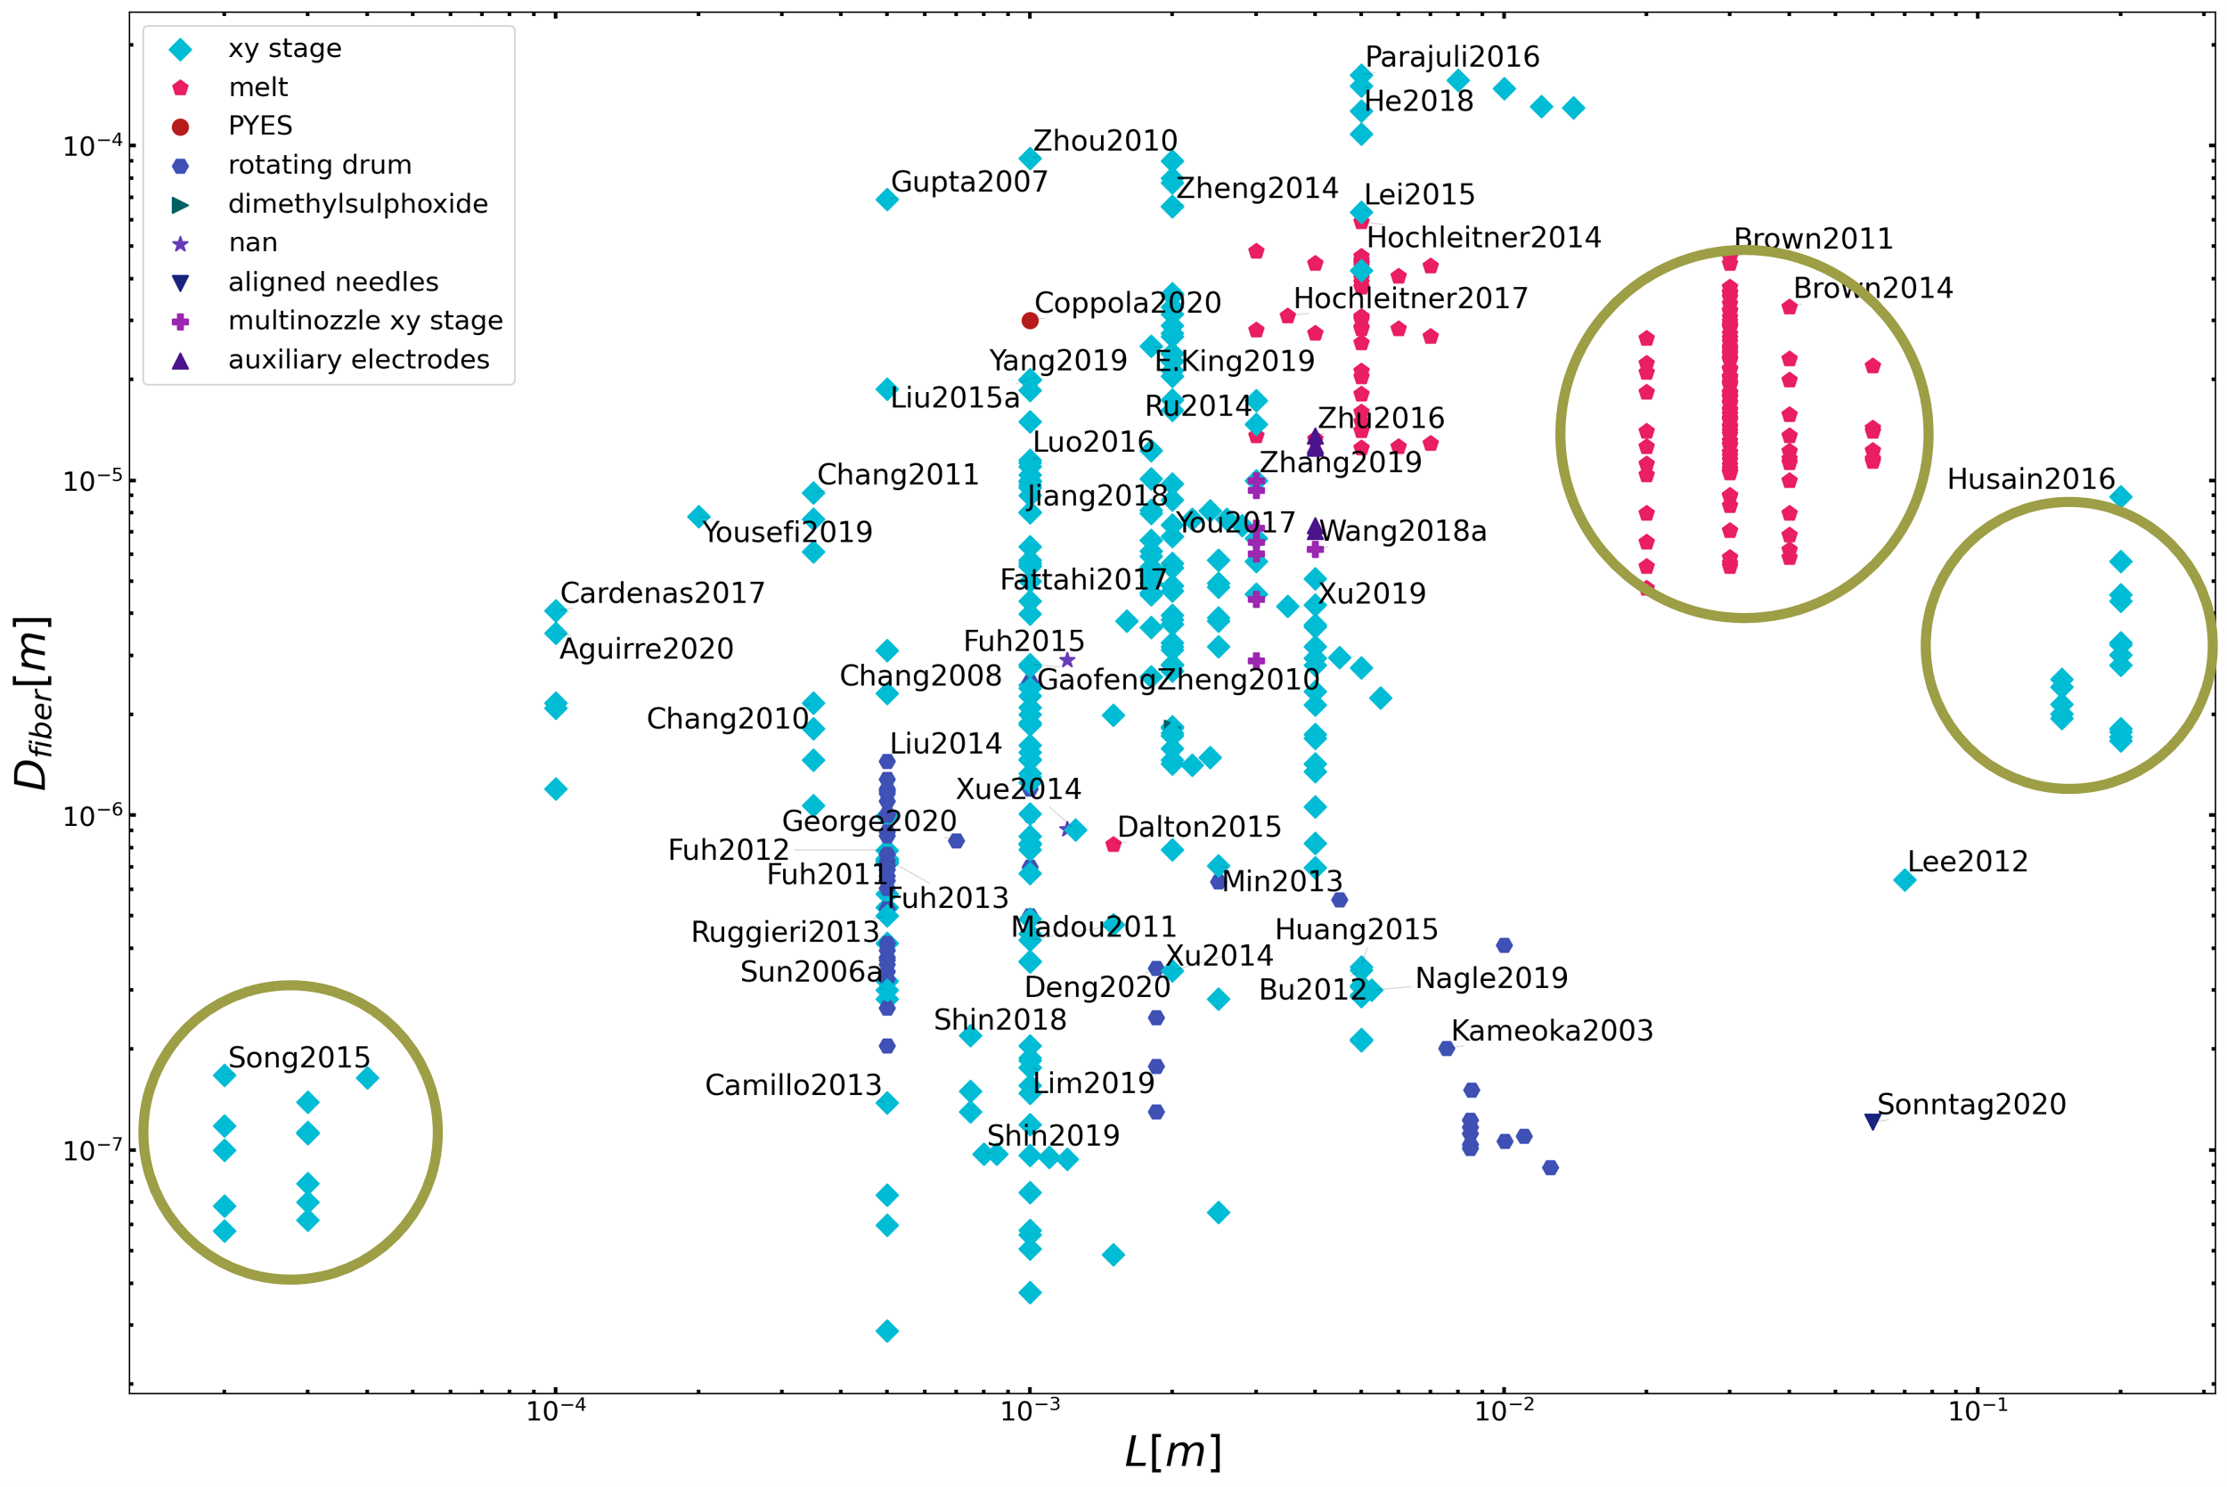
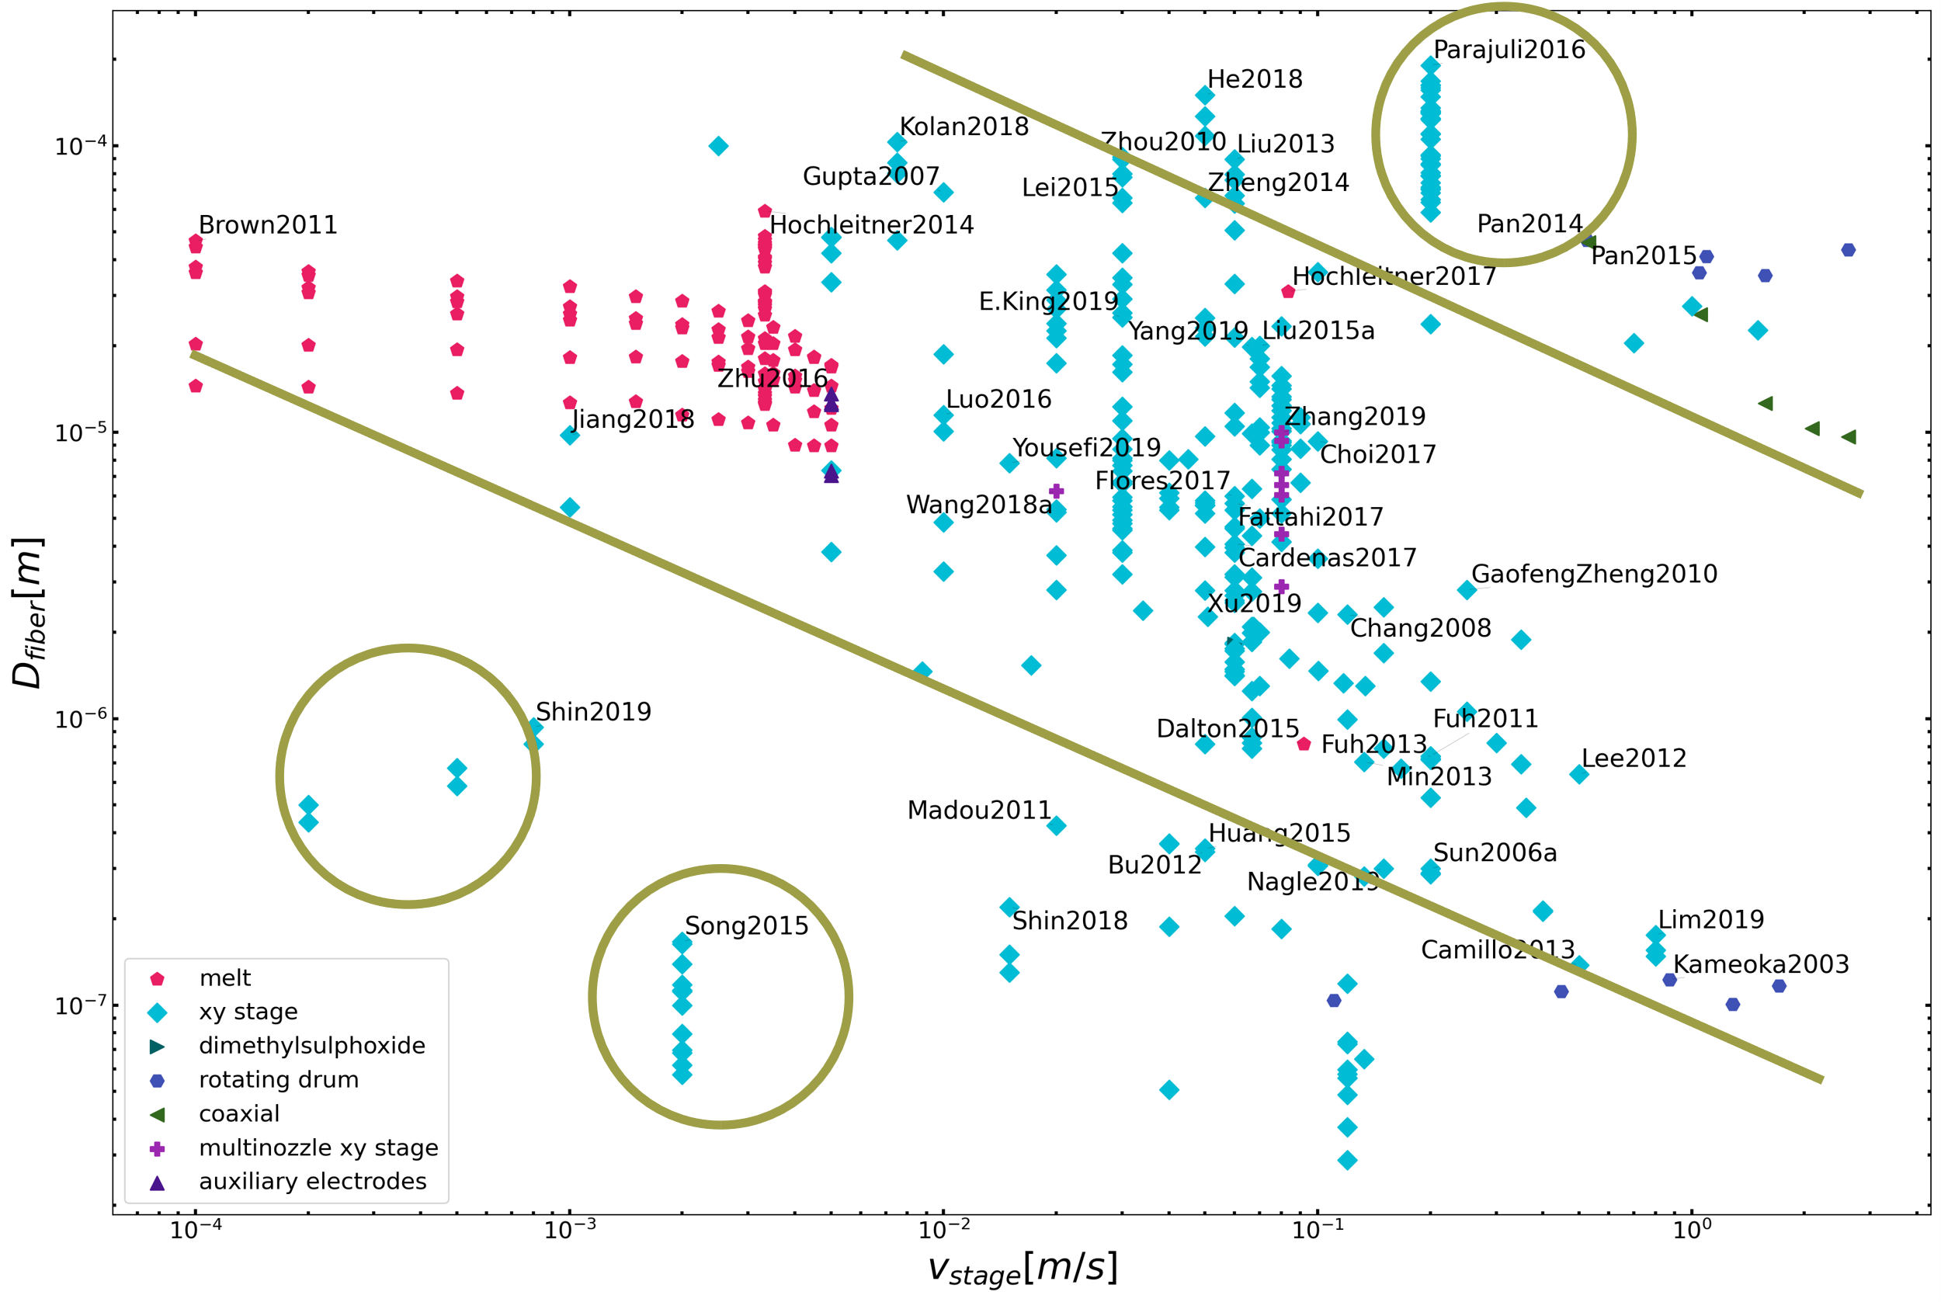
Conclusion 1.2: Let’s focus on polymer concentration
Polymer concentration is the most reliable process parameter to control the morphology of electrospun fibers. (regardless the type of NFES process)
Notes:
Song2015 : glass capillary tip
Brown201X : melt ES
Husain2016 : L = cm
Shin2019 : coiled/meander fibers
Parajuli2016 : concentrations 25 – 80%

Slide 28
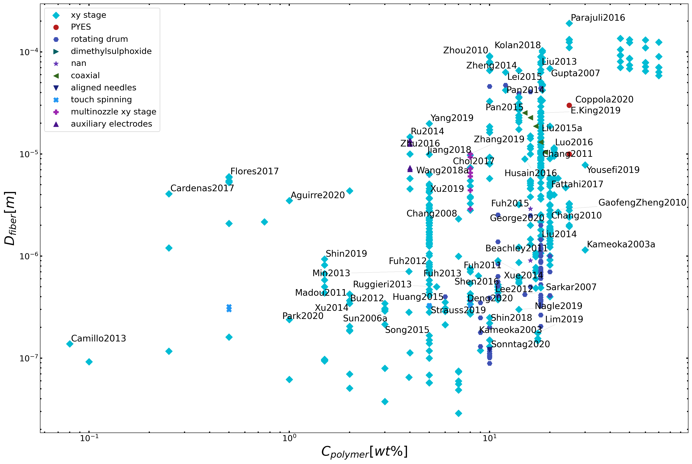
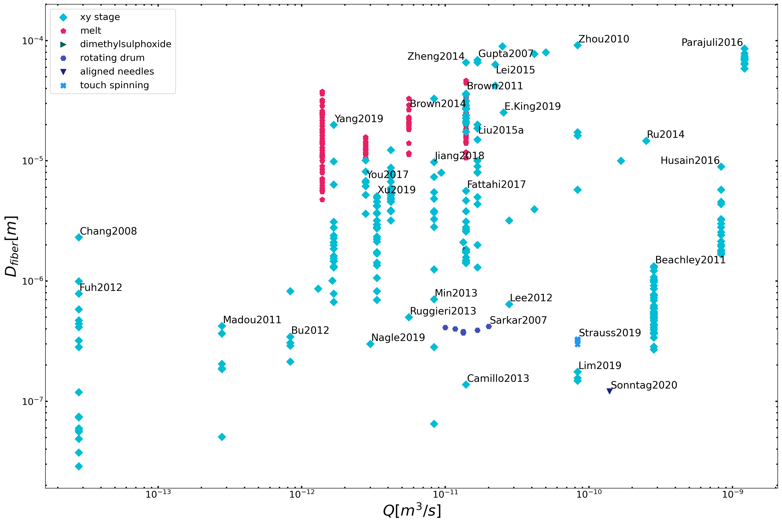
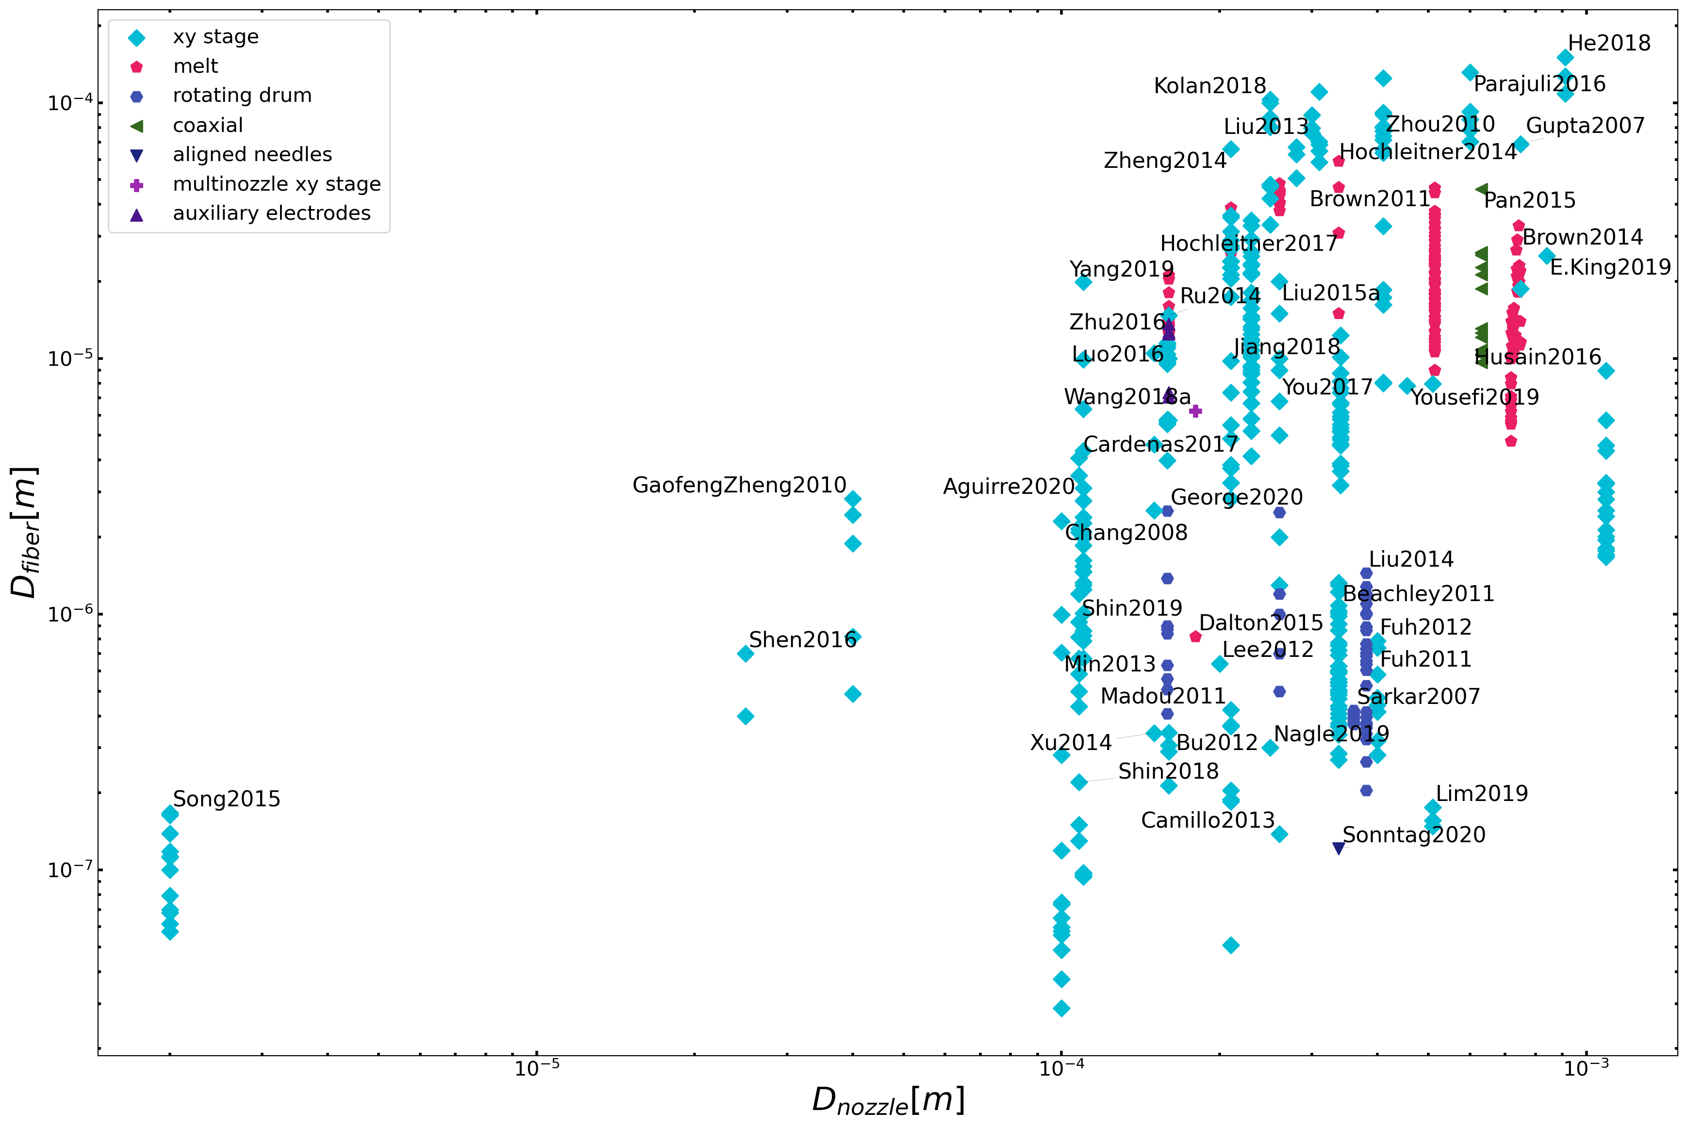
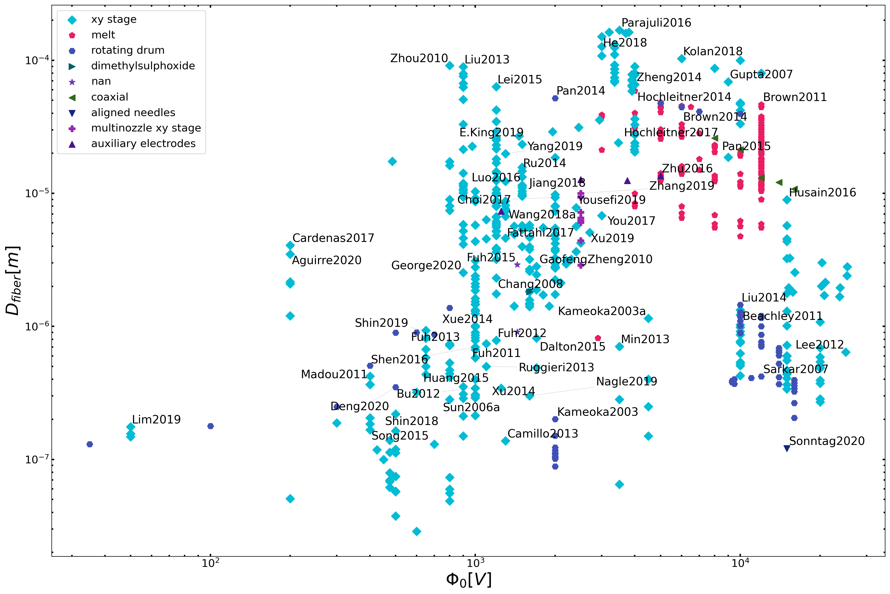
low polymer
concentrations
slow solution flow rates
Conclusion 1.1:
Process Parameters
small needle
diameters
low voltages
28

Slide 29
Diameter Prediction of Electrospun Fibers
The fiber morphology not only depends on the process parameters, but also on the type of electrospinning process and on polymer-solvent system.
“[…] the fiber diameter decreases as the applied voltage increases.”
Helgeson et al.
“[…] neither the collecting distance nor the applied voltage has large influences on fiber diameter […]”
Zhang et al.
“[…] while decreasing the voltage could also be used to reduce the average fiber diameter.”
Brown et al.
The existing interdependence between the process and solution parameters adds complexity and ambiguity to the effect of each parameter
Siddharth B. Gadkari. “Scaling analysis for electrospinning”. In: SpringerPlus 3.1 (Dec. 2014), p. 705. ISSN: 2193-1801. DOI: 10.1186/2193-1801-3-705.
B. Zhang, F. Kang, J.-M. Tarascon, J.-K. Kim, Recent advances in electrospun carbon nanofibers and their application in electrochemical energy storage, Prog. Mater. (2016) https://doi.org/10.1016/j.pmatsci.2015.08.002.
M.E. Helgeson, K.N. Grammatikos, J.M. Deitzel, N.J. Wagner, Theory and kinematic measurements of the mechanics of stable electrospun polymer jets, Polymer (2008) https://doi.org/10.1016/j.polymer.2008.04.025.
T.D. Brown, F. Edin, N. Detta, A.D. Skelton, D.W. Hutmacher, P.D. Dalton, Melt electrospinning of poly(ε-caprolactone) scaffolds: Phenomenological observations associated with collection and direct writing, Mater. Sci. Eng. C. 45 (2014) 698–708. https://doi.org/10.1016/j.msec.2014.07.034.

Slide 30
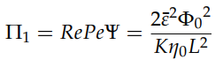
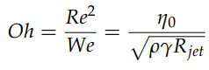
Diameter Prediction of Electrospun Fibers
Helgeson and Wagner have presented an adimensional analysis to
predict the fiber diameter with conservation equations of momentum, mass, electric charge and four dimensionless numbers:
Correlation between the electrostatic and viscous forces:
Ohnesorge number (jet behaviour and capillary rupture):
Helgeson get rid of unknown and/or hard to measure parameters, such as the initial jet velocity.
M.E. Helgeson, N.J. Wagner, A correlation for the diameter of electrospun polymer nanofibers, AIChE J. 53 (2007) 51–55. https://doi.org/10.1002/aic.11056.

Slide 31
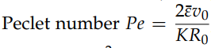
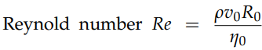
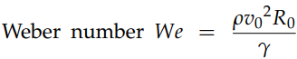
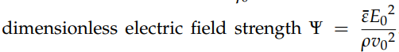
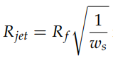
Diameter Prediction of Electrospun Fibers
N. Liu, K. Kim, H.Y. Jeong, P.C. Hsu, Y. Cui, Z. Bao, Effect of Chemical Structure on Polymer-Templated Growth of Graphitic Nanoribbons, ACS Nano. 9 (2015) 9043–9049. https://doi.org/10.1021/acsnano.5b03134.

Slide 32
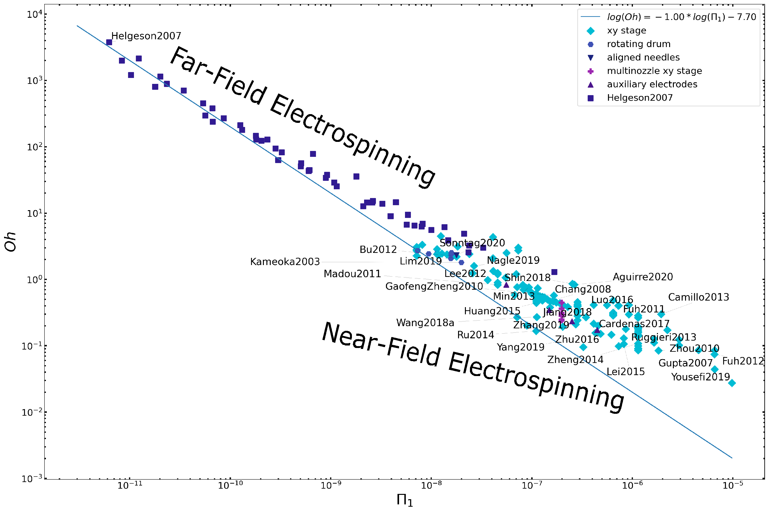
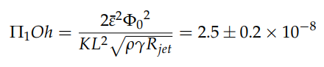
Diameter Prediction of Electrospun Fibers
N. Liu, K. Kim, H.Y. Jeong, P.C. Hsu, Y. Cui, Z. Bao, Effect of Chemical Structure on Polymer-Templated Growth of Graphitic Nanoribbons, ACS Nano. 9 (2015) 9043–9049. https://doi.org/10.1021/acsnano.5b03134.
Notes:
both types of electrospinning behave in a similar manner
the FFES data fits better a linear behavior of slope -1.
As the working distance closes in NFES, the data points fit a shallower slope with higher P1 values and lower Oh values
that in NFES less viscous solutions have been used

Slide 33
Rheology Analyses
Specific Objective 2. Through rheological analyses, determine if polymer solutions have comparative viscoelastic properties to those of the SU-8/PEO benchmark, and if they can be easily electrospun by NFES.

Slide 34
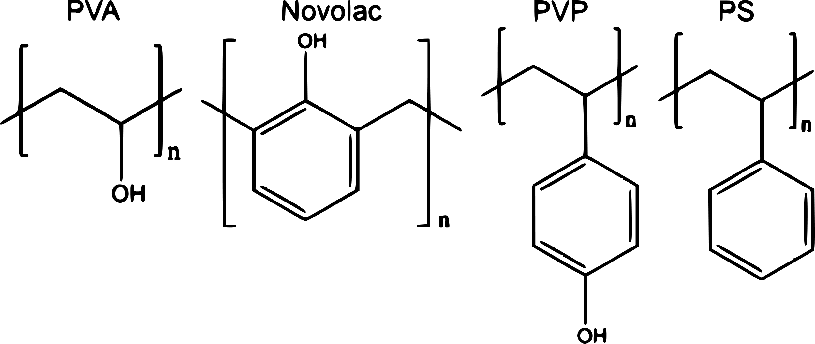
Selection of Polymer-Solvent combinations
Zhenan Bao et al. investigated the effect of the polymer chemical
Structure of:
higher sp2 carbon content translates into higher graphitization degree and higher electrical conductivity
polymers with functional groups are required for the creation of smooth and continuous fibers.
N. Liu, K. Kim, H.Y. Jeong, P.C. Hsu, Y. Cui, Z. Bao, Effect of Chemical Structure on Polymer-Templated Growth of Graphitic Nanoribbons, ACS Nano. 9 (2015) 9043–9049. https://doi.org/10.1021/acsnano.5b03134.
Notes:
Bao lit review
Mention templating effect & pipeline stacking
PVP and Novolac have one benzene ring in each repeating unit,
PVA is mainly made out of sp3 carbon
PS is not functionalized

Slide 35

Conclusion1.3: Selection of Polymer-Solvent combinations
Polymers with high carbon content relative to oxygen content
A.A. Yousefi, A.R. Mohebbi, S. Falahdoost Moghadam, S.A. Poursamar, L. Hao, Uniaxially aligned microwire networks for flexible transparent electrodes using a novel electrospinning set-up, Sol. Energy. 188 (2019) 1111–1117. ttps://doi.org/10.1016/j.solener.2019.07.007.
H. Fong, D.H. Reneker, Elastomeric nanofibers of styrene-butadiene-styrene triblock copolymer, J. Polym. Sci. Part B Polym. Phys. 37 (1999) 3488–3493. https://doi.org/10.1002/(SICI)1099-0488(19991215)37:24<3488::AID-POLB9>3.0.CO;2-M.
S.-Y. Min, T.-S. Kim, B.J. Kim, H. Cho, Y.-Y. Noh, H. Yang, J.H. Cho, T.-W. Lee, Large-scale organic nanowire lithography and electronics, Nat. Commun. 4 (2013) 1773. https://doi.org/10.1038/ncomms2785.
Notes:
Mw
Aromaticidad
Cantidad de carbono
Ratio oxygen / carbon in pyrolysis

Slide 36



Literature claims
Under some critical concentration NFES yields beads or small fibres
Viscosity increases with molecular weight
Over some critical concentration NFES continuous fibres
The general belief is that the molecular weight needs to be sufficient enough to create or induce entanglements
D.R. Flores, Role of rheological properties in near field electrospun fibers morphology, (2017) 130.
G.L. Wilkes, An overview of the basic rheological behavior of polymer fluids with an emphasis on polymer melts, J. Chem. Educ. 58 (1981) 880. https://doi.org/10.1021/ed058p880.

Slide 37

Literature claims
As “electrospinnability” is determined by the polymer chain entanglement,
chain entanglement is controlled by molecular weight,
increasing molecular weight increases viscosity, and
viscosity is controlled by polymer concentration, then
The critical/spinnable concentration can be found in a viscosity vs. concentration plot
critical
concentration
D.R. Flores, Role of rheological properties in near field electrospun fibers morphology, (2017) 130.
G.L. Wilkes, An overview of the basic rheological behavior of polymer fluids with an emphasis on polymer melts, J. Chem. Educ. 58 (1981) 880. https://doi.org/10.1021/ed058p880.

Slide 38


Methods: Sample Preparation (SU8-PEO)
3.0 ml samples
on a heating plate at 160 rpm and 60°C, for 2 hours each.
A salt (TBF) was added to all the samples to increase the electrical conductivity

Slide 39


Methods: Sample Preparation (PS & PSB)

Slide 40


Methods: Sample Preparation (PSB & PSMS)

Slide 41


Methods: Sample Preparation (PVK & SU8-PVK)

Slide 42


Methods: Rheology – Frequency Sweeps
Geometry:
Steel cone plate, Peltier plate
(60.0 mm diameter, 0.9979° cone angle, 23 µm truncation)
Procedure:
Frequency sweep
(20°C, for 20 min
from ${10}^{−3}$ to ${10}^{4}$ 1/s shear rates)

Slide 43



Methods: Rheology – Instrumentation
Measured Parameter | Calculated Parameter
Torque Angular displacement Angular velocity | Stress Strain Shear rate
$$Stress=Torque\left[N∙m\right]∙Stress constant$$
$$Strain=Angular displacement\left[rad\right]∙Strain constant$$
$$Shear rate=Angular velocity\left[\frac{rad}{s}\right]∙Strain constant$$
$$Viscosity=\frac{Stress}{Shear rate}$$
$$Young^{′}s Modulus=\frac{Stress}{Strain}$$
Discovery Hybrid Rheometers – TA Instruments, (n.d.). https://www.tainstruments.com/products/rheology/discovery-hybrid-rheometers/ (accessed 18 May 2020).
Malvern Instruments Worldwide, Malvern Instruments White Paper - A Basic Introduction to Rheology Shear Flow, (2016) 1–20. https://www.malvernpanalytical.com/en/learn/knowledge-center/whitepapers/WP160620BasicIntroRheology.html.

Slide 44




Methods: Rheology – Geometry Selection
Geometry options:
Concentric Cylinders
Cone and Plate
Parallel Plate
Torsion Rectangular
Very Low Viscosity
Solids
Discovery Hybrid Rheometers – TA Instruments, (n.d.). https://www.tainstruments.com/products/rheology/discovery-hybrid-rheometers/ (accessed 18 May 2020).

Slide 45

Methods: Rheology – Radial Migration Effect
High centrifugal stresses result in the sample being thrown out of the measuring area; a phenomenon known as ’radial migration effect’.
Once the ’radial migration effect’ partially ejects the sample, the viscosity measurements are lower than expected due to a drop in torque.
R. W. Connelly and J. Greener. “High-Shear Viscometry with a Rotational Parallel-Disk Device”. In: Journal of Rheology 29.2 (1985), pp. 209–226. ISSN: 0148-6055. DOI: 10.1122/1.549828.
Christopher J Pipe, Trushant S Majmudar, and Gareth H. McKinley. “High shear rate viscometry”. In: Rheologica Acta 47.5-6 (July 2008), pp. 621–642. ISSN: 0035-4511. DOI: 10.1007/s00397- 008- 0268- 1. URL: http://link.springer.com/10.1007/s00397-008-0268-1.

Slide 46



Methods: The Carreau-Yasuda Model
$$η=\frac{η_{0}−η_{∞}}{{\left[1+{\left(κ\dot{γ}\right)}^{a}\right]}^{\frac{1−n}{a}}}+η_{∞}$$
$η$: viscosity
$\dot{γ}$: shear rate
$η_{∞}$: infinite shear rate viscosity
$η_{0}$: zero shear rate viscosity
$κ$: time constant
$n$: Power Law index
$a$: width of the transition region

Slide 47


Methods: Other models:

Slide 48


Methods: Other models:

Slide 49




Methods: Rheology results validation for 0wt% PEO
and 0wt% PVK
Measured:
$$\left(8.05±0.28\right) mPa⋅s$$
from PEO in SU8
sample set
vs.
MicroChem data sheet:
$$\frac{7.5cSt \left(1.123g/ml\right)}{1000cSt⋅s⋅m⋅g/ml⋅Kg}=8.422 mPa⋅s$$
from PVK in SU8
sample set
$$1.09 \%error$$
Microchem, Su-8 2000.5, 2002, 2005, 2007, 2010, 2015, Microchem. (2018) 1–5. papers3://publication/uuid/859F51B9-0382-4DE8-88A9-267F936939A3.

Slide 50




Methods: Rheology results validation for 0wt% PVK
Measured CHL viscosity:
$$0.499 mPa⋅s$$
vs.
Anton-Paar data sheet:
$$0.563 mPa⋅s$$
$$11.36 \%error$$
https://wiki.anton-paar.com/en/chloroform/

Slide 51


D.R. Flores, Role of rheological properties in near field electrospun fibers morphology, (2017) 130.
Notes:
D.R. Flores, Role of rheological properties in near field electrospun fibers morphology, (2017) 130.

Slide 52

Methods: Rheology results validation
D.R. Flores-hernandez, B. Cardenas-benitez, S.O. Martinez-chapa, J. Bonilla-rios, Tailoring the Diameters of Electro-Mechanically Spun Fibers by Controlling Their Deborah Numbers, (2020). https://doi.org/10.3390/polym12061358.
Notes:
D.R. Flores-hernandez, B. Cardenas-benitez, S.O. Martinez-chapa, J. Bonilla-rios, Tailoring the Diameters of Electro-Mechanically Spun Fibers by Controlling Their Deborah Numbers, (2020). https://doi.org/10.3390/polym12061358.

Slide 53

Methods: Rheology results validation
G.S. Bisht, G. Canton, A. Mirsepassi, L. Kulinsky, S. Oh, D. Dunn-Rankin, M.J. Madou, D. Dunn-Rankin, L. Kulinsky, A. Mirsepassi, G.S. Bisht, S. Oh, G. Canton, Controlled Continuous Patterning of Polymeric Nanofibers on Three-Dimensional Substrates Using Low-Voltage Near-Field Electrospinning, Nano Lett. 11 (2011) 1831–1837. https://doi.org/10.1021/nl2006164.
Notes:
D.R. Flores-hernandez, B. Cardenas-benitez, S.O. Martinez-chapa, J. Bonilla-rios, Tailoring the Diameters of Electro-Mechanically Spun Fibers by Controlling Their Deborah Numbers, (2020). https://doi.org/10.3390/polym12061358.

Slide 54

Spinnable/Critical Concentration
non-spinnable concentrations
spinnable
concentrations
c*=25 wt%

Slide 55

Spinnable/Critical Concentration

Slide 56


Conclusion2.1: Spinnable/Critical Concentration
A low molecular weight shall be compensated with higher concentrations to reach a spunable viscosity.
Vu Anh Doan et al. “Interphase transfer of tackifier between poly(butadiene) and poly(styrene-co-butadiene)”. In: Journal of Materials Science 48.5 (Mar. 2013), pp. 2046–2052. ISSN: 0022-2461. DOI: 10.1007/s10853- 012- 6974- 1. URL: http://link.springer.com/10.1007/s10853-012-6974-1.
Ralph H. Colby, Lewis J. Fetters, and William W. Graessley. “The melt viscosity-molecular weight relationship for linear polymers”. In: Macromolecules 20.9 (Sept. 1987), pp. 2226–2237. ISSN: 0024-9297. DOI: 10 . 1021 / ma00175a030. URL: https : / / pubs . acs . org / doi / abs / 10 . 1021 / ma00175a030.

Slide 57

c*

Slide 58

c*

Slide 59
c*

Slide 60

c*

Slide 61

c*

Slide 62

c*

Slide 63
Fabrication & Characterization
Specific Objective 3. Propose alternatives to the SU-8/PEO benchmark formulation for the production of microscopic polymer fibers with potential for the fabrication of carbon nano-wires.

Slide 64


Methods: Design of experiments / NFES
Given the results of previous work, the experiments shall reflect:
The SU8-PEO sample set is the control
The calculated critical concentration were used for each sample set.
Each sample was electrospun at different applied voltages from 200 to 600V
Other process parameters (working distance, stage velocity, flow rate) are to be tuned and remain constant during NFES.
Domingo R Flores-hernandez et al. “Tailoring the Diameters of Electro-Mechanically Spun Fibers by Controlling Their Deborah Numbers”. In: (2020). DOI: 10.3390/polym12061358.

Slide 65




Fabrication: Process Parameters
0.25 wt% PEO in SU-8
Fabrication velocity: 10 mm/s
Working distance: 0.5 mm
Applied voltage: 200V to 600V
Applied current: 10 uA
Flow rate: 0.04 uL/min
Spacing: 10um
600V
900V

Slide 66


Characterization:
PEO in SU-8

Slide 67


PSB in THF and DMF
PS in THF

Slide 68


PVK in CHL
PVK in SU-8

Slide 69

non-spinnable solutions
Polymer / Solvent | Critical concentration | Rationale
Poly(Styrene-co-alpha-Methylstyrene) (PSMS) in N,N-Dimethylformamide(DMF) | 5 wt% (and 10, 15 wt%) | Fibres were broken into agglomerates / dust
Poly(Styrene-co-Butadiene) (PSB) in 1-Methyl-2-Pyrrolidinone (NMP) | 8.00 wt% | Development of a shell around the drop.
PSMS
Notes:
Poly(Styrene-co-Butadiene)
1-Methyl-2-Pyrrolidinone
7.74 wt%

Slide 70

Results: Spinnable solutions

Slide 71
Conclusions & Future Work

Slide 72
Helgeson’s Dimensionless analysis
Helgeson’s model was thought to work with far-field electrospinning, hence the deviation of the NFES data from the model trend.
For an accurate NFES fiber diameter prediction, the mechanical stresses introduced by the moving stage shall be considered in the model

Slide 73
Pyrolysis Process
This work verifies the electro-spinnability of four new formulations and one modification to the PEO/SU-8 solution, however fibers were not carbonized into carbon structures.
Further work shall study the pyrolysis process of the proposed fibers to get carbon structures with good electrical conductivity.
A photo-polymerization process could be introduced before pyrolysis to increase the order of the molecules and achieve carbon with higher
conductivity.

Slide 74
Process Parameters
The viscosity-concentration plot is a helpful tool to estimate the critical spinnable concentration of a polymer-solvent system as NFES solutions require specific viscosities to initiate a polymer jet. However there is room for improvement as this method only considers rheological data.
Other methods could be adopted to better tune other process parameters such as stage velocity, and applied voltage.

Slide 75













Slide 76

Any Questions?

Slide 77


SU-8 (MicroChem, US)
Notes:
https://rsc.aux.eng.ufl.edu/_files/msds/309.pdf

Slide 78
Carbon nanostructures via Lithography
The production of C-MEMS:
Polymer patterning through photolithography electrospinning
Carbonization through pyrolysis
photolithography process
● SU-8 Waste
● Physical & Optical Limitations
● Structure Limitations

Slide 79

TPP – Two-Photon Polymerization
B. Cardenas-Benitez, C. Eschenbaum, D. Mager, J.G. Korvink, M.J. Madou, U. Lemmer, I. De Leon, S.O. Martinez-Chapa, Pyrolysis-induced shrinking of three-dimensional structures fabricated by two-photon polymerization: experiment and theoretical model, Microsystems Nanoeng. 5 (2019). https://doi.org/10.1038/s41378-019-0079-9.

Slide 80


Characterization of the 0.25 wt% PEO Solution
Notes:
Surface t-

Slide 81


Slide 82










wt% in THF & DMF
wt% in NMP
wt% in DMF
wt% in THF
wt% in CHL
wt% in SU-8

Slide 83



Slide 84




Slide 85



Slide 86



SU-8 (MicroChem, US)
https://www.fishersci.com/shop/products/NC9901158/nc9901158#?keyword=SU-8++developer
https://www.fishersci.com/shop/products/NC0702370/nc0702370#?keyword=MICROCHEM+CORP+PHOTORESIST+SU-8
Notes:
https://rsc.aux.eng.ufl.edu/_files/msds/309.pdf

Slide 87

Materials

Slide 88
title:
<a point>
<another point>
<content> <key concept> <key concept>
D.R. Flores-hernandez, B. Cardenas-benitez, S.O. Martinez-chapa, J. Bonilla-rios, Tailoring the Diameters of Electro-Mechanically Spun Fibers by Controlling Their Deborah Numbers, (2020). https://doi.org/10.3390/polym12061358.

